Slide 1

HPC Guidance module 4.
How to carry out a Protection and AoRs joint analysis?

Slide 2
This module covers:
Definitions of joint analysis and recommended approaches.
Sequence of the joint analysis process.
Overall objective of this module is to:
Support Protection Cluster and AoR Coordinators at national and subnational levels to carry out an effective and easy to follow joint analysis process for the HNO and PAF roll out.
Joint analysis shouldn’t represent more than 5% for the overall dedicated time for any of two exercises.

Slide 3
What is Protection Joint Analysis?
Q&A
Protection
Joint Analysis
Protection Joint Analysis is an exercise in which the Protection, AoRs partners and stakeholders proceed with the interpretation, endorsement and/or review of the results, findings and recommendations coming from the data analysis.
Joint Analysis can follow several formats such as meetings, webinars or workshops depending on the context.

Slide 4
What is the objective of Joint Analysis?
Q&A
Protection
Joint Analysis
The main objective of a joint analysis exercise is to get the buy in via consensus on the Severity ranking, People in Need (PiN) figures, priority protection threats etc.
The inclusion and participation of Protection actors partners and stakeholders in this process is really critical.

Slide 5
Joint Analysis
Step by Step
  Step 1 : The sequence
Protection Cluster and AoRs can choose one of the two options listed below:
Option 1: Can organize a collective session on joint analysis. This collaborative approach will send out a message of leadership on the protection analysis.
Option 2: AoRs can convene their own joint analysis sessions with their constituencies. If this is the case, the joint analysis session should happen after the Protection Cluster has finalised the same process.
  The reason for this approach on option 2 is that during the sessions, overarching severity and PiN might be modified and threats reviewed and that would have implications in the AoR specific work.
NB: Before organizing a joint analysis session it is required that Cluster and AoRs have finalised the draft severity ranking, PiN, priority threats etc.

Slide 6
Joint Analysis
Step by Step
  Step 2 : The scope
In terms of the scope, Protection Cluster and AoRs can:
Option 1: Organize joint analysis sessions at sub-national level and bring the sub-national results to a final national level joint analysis session.
  This option will ensure the participation, buy in and inclusion of national and local partners and stakeholders during the analysis.
Option 2: Carry out a single national level joint analysis workshop. This option is only recommended when either the country of operations is in the first phase (i.e., first 3 months) of the response, there is a very limited number of protection partners and stakeholders, or humanitarian access is restricted.

Slide 7
Joint Analysis
Step by Step
  Step 2 : The participants
The profile of participants in the joint analysis sessions can be summarized in a single sentence; the full constituency of Protection and AoRs partners and key stakeholders.
The constituency varies from country to country, and it is the decision of the coordinators to decide about the number and profile of the participants. Some examples of constituencies are: National and local authorities; national and local partners; National and local NGO forums; International partners; Information Management WGs, OCHA, donors or other clusters, specially if protection is seeking to reinforce and foster Protection mainstreaming and integrated approaches.

Slide 8
Joint Analysis
Step by Step
  Step 3 : Joint analysis sessions dynamics
During the joint analysis session, Protection Cluster and AoRs can provide to participants an overview of the following:
  HPC process,
  HPC timeline,
  selection and use of indicators,
  identified protection threats,
  selection of the PiN % for each of the population groups,
  internal analysis process,
  interaction with other clusters, OCHA etc.

Slide 9
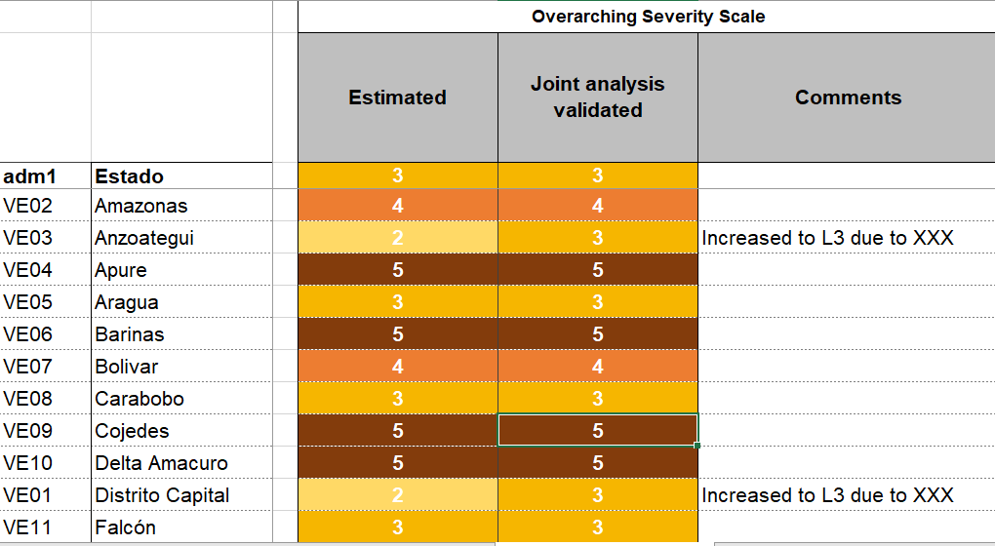
Joint Analysis
Step by Step
  Step 3 : Joint analysis sessions dynamics
2) Review in plenary the finalized severity ranking by each geographical unit of analysis explaining the process and the initial ranking and the identified protection threats.
After discussion, participants will proceed to either endorse or review the severity as shown in this example from Venezuela (2019) :

Slide 10
Joint Analysis
Step by Step
  Step 3 : Joint analysis sessions dynamics
If after discussion there is consensus on the ranking, the session can move to the next geographical unit of analysis and so on until the finalisation of the review.
However, if there is no consensus, the severity ranking of the unit of analysis should be discussed in plenary. The ranking review can represent either increasing or decreasing the severity of the unit of analysis and any change should be supported by:
Context knowledge/update (on this regard, national and local actors can play a key role together with the roll out of sub-national joint analysis sessions)
Additional data/information regarding the specific geographical unit of analysis (i.e., presence/lack of unreported armed groups, recent arriving/departing population influx etc.)
Confirmed presence/ or lack of a protection threat in the area.

Slide 11
Joint Analysis
Step by Step
  Remember that:
Changes in the severity ranking will have a direct impact on the PiN estimates. If the ranking increases or decreases after the joint analysis sessions; the % of PiN should change accordingly for that unit of analysis.
The final outcomes of the joint analysis is a final severity ranking, PiN and priority threats. These outcomes will have direct linkages with the HRP in terms of Protection Strategic and sectoral objectives, priority areas and groups, targeting and overall response strategy.

Slide 12
Is this Joint Analysis guidance valid as well when rolling out the PAF aside of the HNO?
Q&A
Protection
Joint Analysis
Yes, this module guides you on how to carry out a joint analysis session as the last step of the HNO analysis. The rationale of sequence, scope and dynamics sections can be easily used for PAF threats-based analysis. If you want to discuss more on detail this aspect, please feel free to contact the GPC Protection Analysis Pillar team.

Slide 13
This is the end of HPC Guidance module 4:
How to carry out a Protection and AoRs joint analysis?
We invite you now to go through the following modules. Thanks for listening.

