Slide 1



Social media guidelines to country clusters
May 2022

Slide 2


Why communicating on social media?
To inform about the clusters and cluster partners work in the country of operations
  fact sheets, updates, sitreps, key documents, news, activities, missions, human stories
To create engagement with key stakeholders
=> tagging (@) specific partners or stakeholders, liking and sharing posts of partners, or highlighting the work of cluster partners
3. To contribute to the visibility of the country operations and advocacy on the humanitarian situation.

Slide 3
What are some good practices?
Inclusive collaboration
  Joint social media campaigns
  Key international days and events
Strengthening localization objectives
  by giving visibility to the work of local partners
Reaching a wider public through:
  avoiding the use of acronyms
  conveying strong and crisp messages
  aesthetically appealing with visuals, graphics and short videos
Amplifying the voice of the affected populations
by sharing powerful video statements, testimonies and photographs

Slide 4
What are the Do-s and Don’t-s?
Do-s | Don’t-s
Consent Dignified photos Credits Validation process Correct misrepresentation with factual info Verify sources Use hashtags (#) and tags (@) | No hateful content No personal info / details No name-and-shame Don’t compromise security Don’t jeopardize neutrality and independence

Slide 5
Social media scheduling template
Date and Status | Text | Visual | Tags and hashtags | Proposed by
If the message is timebound (for an event, campaign,…) mention the ideal date to be published | Twitter: Keep the messages short (1 to 3 sentences) LinkedIn: Longer texts are possible – better to provide simple explanations with relevant hashtags and account tags Facebook & Instagram: Texts should not be too long. Messages should be crisp and catchy. | If you have a visual in mind, share here a thumbnail or a link to a picture To each social media corresponds a specific size (i.e., for Twitter and LinkedIn, landscape pictures are strongly recommended) Mention the copyright and/or tag the organization who holds the copyrights | Tags (@): If any partners, organizations or individuals need to be tagged, mention them (depending on the social, you can tag the picture) Hashtags (#): max 3 Events, topics, keywords etc. | Person and organization proposing a message

Slide 6
Global VS country accounts
Global accounts | Country accounts
Advantages SM accounts / comms team already established Global visibility A uniform branding Disadvantages Increasing lines of communication No personal branding | Advantages Flexibility to plan and schedule posts Own branding Sharing partners’ activities Disadvantages Additional workload Time to build audience reach (followers, impressions etc.) Dedicating ample time to plan for social media posts and adequate content Sometimes limited ability to balance among all cluster partners when publishing

Slide 7
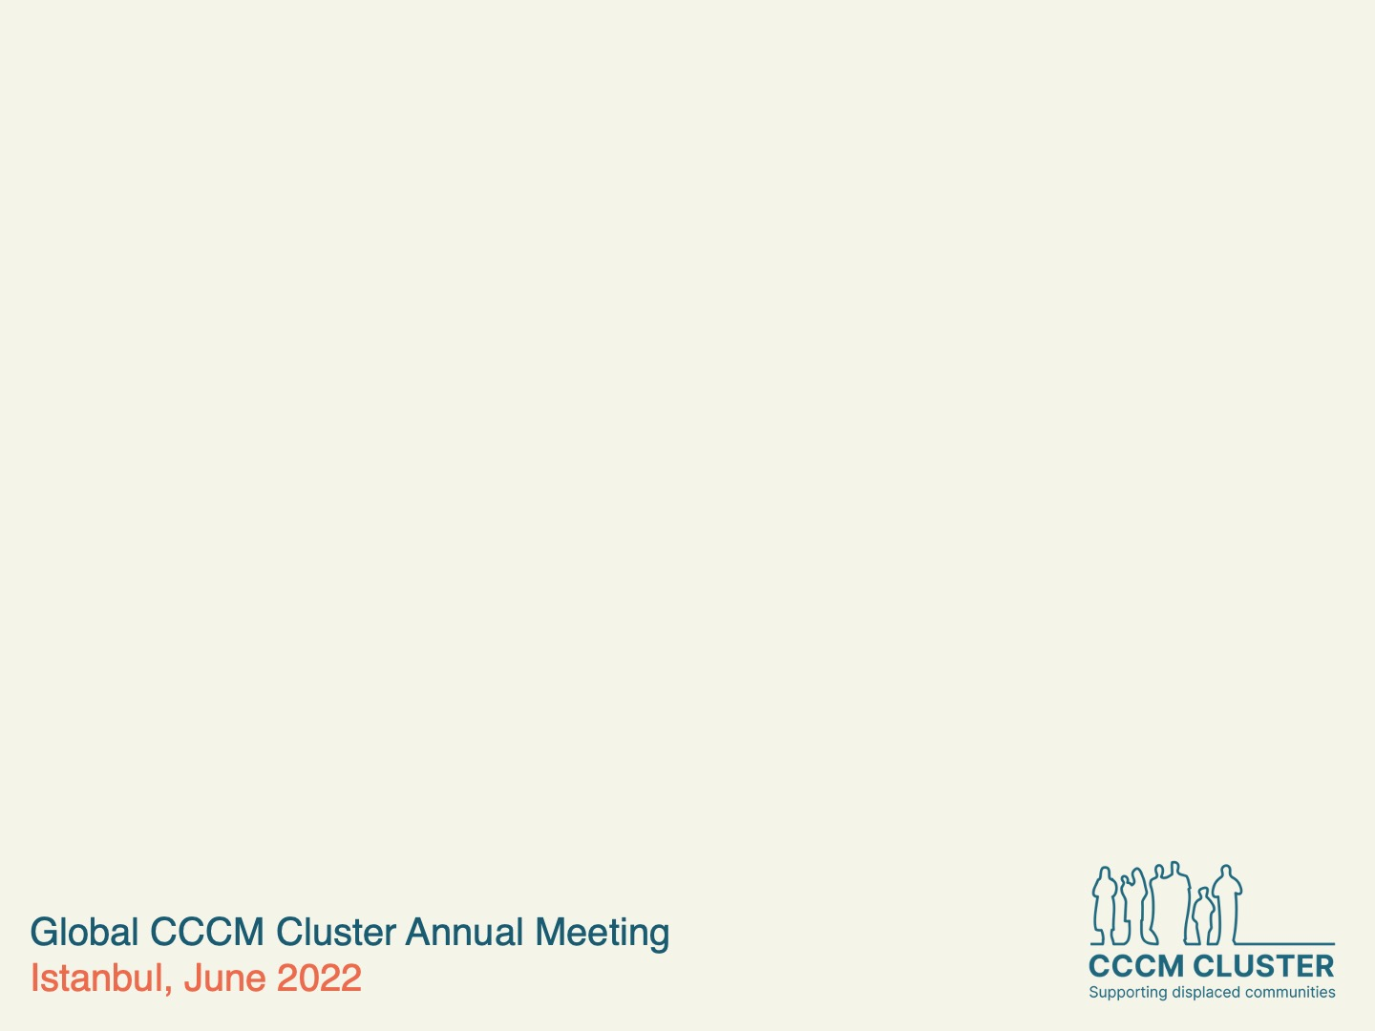




Global cluster social media accounts
@ProtectionClust
@Global Protection Cluster
globalprotectioncluster.org

