Slide 1
Referral pathways and Service mapping
Training of trainers

Slide 2
Agenda
Why referrals?
Prioritizing people with specific needs
The referral process for Protection referrals
  Step 1: Psychological First Aid (PFA)
  Step 2: Options and consent
  Step 3: Data collection
  Step 4: Contacting the service provider
  Step 5: Following-up on the referral
Referrals in Ukraine
Notes:
Introduce yourself
Ask participants to introduce themselves
Set the ground rules for the training: learning, respectful communication and sharing of opinions, not being afraid to ask questions, no phones
Present the overall agenda

Slide 3
Learning outcomes
Recognize the importance of safe and timely referrals to enhance access to services
Understand vulnerability and how to prioritize the most vulnerable in Ukraine, notably when receiving referrals
Learn about Protection referrals step by step, key guiding principles, approaches and tools
Ensure a common understanding of current referral pathways in Ukraine
Notes:
Introduce the learning outcomes for the overall training: ‘’This is what we are trying to achieve with this training, this is what you will know by the end of this training’’

Slide 4
Why referrals?
Notes:
This section focuses on why referrals matter.
Referrals are a key element of Protection work and beyond - and require to abide to certain principles, ways of working, processes, which can be time-consuming. It is therefore essential for us all to be on the same page on why we dedicate time to referrals in our daily work, and why we must continue to do so.

Slide 5
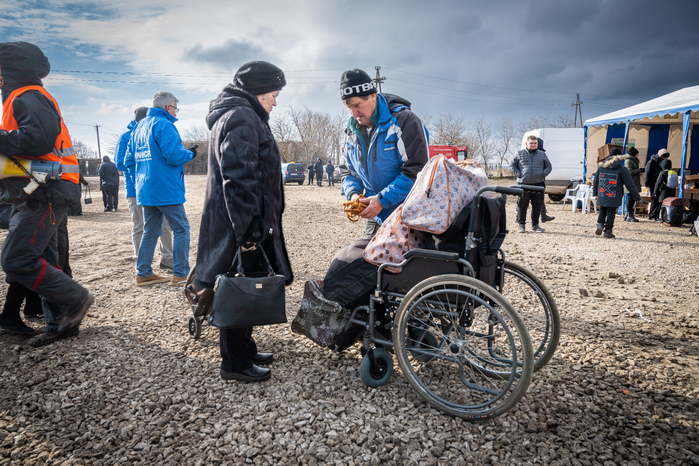
© UNHCR/Mihai von Eremia
Notes:
Start with a discussion to understand together why referrals are important. Involve participants by asking them:
What do you think this lady is doing? She is trying to get help/support (see the guy with her and the tent which is likely a support point). For what service? Any service, health, food, shelter etc.
What barriers might she experience in accessing those services? Physically, if they are adapted to people with wheelchairs if she cannot walk/queue for long. Might need someone to help her if poor infrastructure. Whether those services are indeed available for her, when do they open/close. Not being consulted about what she needs. Not knowing what services are available.
Do you think she has been consulted on the location and access routes to those services? Unlikely
Who is responsible for ensuring she can safely access those services? Everyone!
Conclude by highlighting that in the absence of fully functioning social state services, it is the responsibility of all humanitarian staff to consider the situation of this lady and support her in accessing services. We must be able to inform people about services and assistance which exist beyond what we provide (beyond scope of our own projects and sectors) and to be able to safely refer people to the services that they need.
So why do referrals matter? (transition to next slide)

Slide 6

Shelter & NFI
Protection
WASH
Nutrition
Health
Food Security
Education
Notes:
Explain that: in short referrals connect humanitarian service providers together – and as we have seen in the previous example, people face a multitude of needs
From the same area of work: because some humanitarian actors might be overwhelmed and unable to further assist a person, and therefore need to rely on another organization to provide the same needed support to this person
Across areas of work: because humanitarian actors have specific technical expertise (heath, protection), but that individuals/families affected by crises have a multitude of needs and therefore require different types of assistance. It is essential that humanitarian actors closely coordinate between each other to ensure that individuals/families are able to receive ALL the services that they need, and not just the one they can themselves provide.
By connecting humanitarian actors together, referrals support increased access to multi-sector services for people.

Slide 7
The importance of referrals
Adopt a multi-sector, holistic approach to people’s needs
Increase access to services
Overcome specific barriers to access services
Ensure accountability to people, and to each other
Connect humanitarian services providers together and with social services
Helps identify gaps and barriers to access services
Notes:
Explain that this is why referrals are so important:
Because people face a multitude of needs, therefore coordination between Clusters is essential to provide safe and timely access to multi-sector services
Because we have the responsibility as humanitarian actors to ensure that people have access to any service that they need, even beyond our area of expertise. We have special access to some of the knowledge and the tools that helps us be in touch with the necessary organizations who provide humanitarian services, so we must leverage them to help people
Notably for those people who may not be able to self-refer, that is, to reach services by themselves (physically or by phone), we will help them overcome those barriers by linking them to the organization that can support them
It is a way to ensure that we remain accountable to the people that we serve, by facilitating them addressing their multiple needs, and to each other by adequately coordinating with each other
It strengthens coordination not only between us as humanitarian actors but also with social services that are particularly strong in Ukraine and the duty-bearers, and is therefore a more sustainable approach
It helps identify gaps in services and barriers to access services, to address them in a more sustainable manner with more funding/services and services better suited for people
(Link to the next slide): however, ensuring that people access services and referrals can be extremely challenging during emergencies

Slide 8
What challenges do you currently face with referrals in Ukraine?
Notes:
Ask the participants to share two or three examples of practical challenges that they have faced when making referrals – ideally, in the context of Ukraine
(Transition to next slide): you have mentioned a variety of different challenges with referrals, and to summarize we will see in the next slide what are the most frequent challenges and we will add the ones that you mentioned that are not currently on the list after the training, thanks for sharing your experiences.

Slide 9
Additional challenges with referrals
I am unsure of what services are available in the area
I cannot find the organization’s contact information
I am not sure that this organization provides services for this specific group (children etc.)
The organization does not answer the phone nor email when I try to contact them
The organization answers saying they will contact the person, but I never heard back nor did the person
The organization says that they will deliver the service, but I am unsure whether the service was indeed delivered
Notes:
Acknowledge that many of those challenges were already mentioned by participants in the previous exercise, and that indeed, they are the most common challenges with referrals in humanitarian emergencies that we see in any humanitarian response, including in Ukraine. Summarize the main challenges:
It is often difficult to know which organizations operate where and what kind of services they provide, in a specific area, in the absence of a service mapping
Their contact details may not be easy to find. Coordination on the ground may be more based on personal connection between staff members across organizations, but how to find the contact details of an organization where I do not know anyone
People may be referred to the wrong service provider, who does not deal with these specific groups, meaning that this person needs to be re-referred, further lengthening the process. Problems with eligibility criteria and target groups. Need to ensure that we send to the right organization
The organization that does not respond = referrals that never receive any feedback
The organization that takes a long time to respond because they are overwhelmed with work = Referrals that are responded to in a long timeframe
Uncertainty around whether the service was actually provided
This impacts the timely referral and reception of services for individuals whose needs are acute and must be responded to in an acceptable timeframe. It is also disheartening for persons who referred to not receive feedback, or in a long timeframe.
This is why we develop tools such as the Service Mapping tool, and guidance such as referral minimum standards and the inter-agency referral form, in order to support partners with finding the right service providers to coordinate with, and to have similar attitudes and expectations towards the referral process.

Slide 10
Key messages
Referrals help people address their multiple needs by accessing relevant services
Notably for those who face specific barriers to access services
Safe and timely referrals are essential
Tools/processes help overcome common challenges with referrals
Eventually be more accountable and efficient in our response

Slide 11
Prioritizing people with specific needs
Notes:
This section focuses on how to prioritize people with specific needs when planning for and delivering assistance. This includes understanding who is in a vulnerable situation and who is most at risk. It is important to know for when an organization receives a referral, given the high demand for services and the stretched capacity for organizations to deliver those services.
The Protection Cluster in Ukraine developed a guidance note on this.

Slide 12
Vulnerability
Situations of vulnerability arise from various circumstances
Shaped by personal (internal) factors and environmental (external) factors
People may not able to enjoy equal access to human rights and may be more exposed to threats/risks and/or marginalized
Notes:
Start by explaining that people with specific needs are people who find themselves in a ‘’vulnerable situation’’:
Vulnerability depends on circumstances (gender, age etc.)
And on internal and external factors
People are, or become, more vulnerable due to a combination of physical, social, environmental, economical and political factors.
Vulnerability is not a fixed category and can change over time with changing circumstances.
Not everyone with the same characteristics will experience the same level of vulnerability, i.e. being a woman does not make the person vulnerable per se but a pregnant woman whose husband was killed and whose house has been damaged will have protection concerns.
The consequence of being in a vulnerable situation is that people may not be able to enjoy equal access to human rights and may be more exposed to certain risks/threats. This leads humanitarian actors sometimes to have more focus on specific individuals/groups.

Slide 13
Why prioritize?
Identify those most in need
Allocate funding and resources
Avoid unintended consequences and future protection issues
Prioritization criteria should be human rights-based, evidence-based, relevant and accurate
Have the full picture with an assessment
Ensure community participation
Notes:
Explain that it is essential to prioritize because:
The conflict in Ukraine does not affect all in the same manner: some people may be particularly affected due to their specific situations
Due to stretched resources and funding, it is essential to ensure that assistance is targeted and goes to those most affected
It will help mitigate potential risks and avoid tensions if communities understand why aid is allocated as it is – complaints and feedback mechanisms are particularly essential for this
To prioritize assistance, we need to develop criteria. These criteria should not be arbitrarily developed but based on human rights, evidence, and must be relevant to the context and accurate
For this we need proper data to be collected on people’s profiles and needs, with disaggregated data (gender, age, marital status, serious medical conditions) to have a full picture
In all phases of targeting, the community must be involved (assessment, deciding type of assistance, sharing of information with beneficiaries etc.)
It is therefore importance to prioritize assistance when we come across someone in need of services/receive a referral of someone in need of a service.

Slide 14
Vulnerability analysis
For IDPs
Circumstances leading to displacement
Primary needs (shelter, food, health)
For people in conflict areas
Have family members been killed/injured during the conflict?
Are the persons suffering from additional economic hardship, lost their job or cannot use their farmland due to mine contamination or proximity to conflict-affected areas?
Duration of displacement
Do they have access to livelihoods or other sources of income in the host community?
Access to assistance
Access to documentation
Psychosocial assistance
Displaced persons at risk of eviction from communal sites or private accommodation
Is there an access issue?
Are they receiving humanitarian assistance from other actors?
Will your actions expose the people targeted to harm?
What is the situation of people who have been unable to move out of these areas due to disability, poverty or lack of support networks elsewhere, including those living in institutions?
Have members of the families been detained, abducted or are missing?
Persons living in institutions which have been cut off from services and staff payments may need additional attention
Have members of the families been exploited in any kind of forced labor including sexual exploitation?
Do people have particular issues when it comes to housing, land and property (HLP) rights?
Do people have particular issues when it comes to housing, land and property (HLP) rights?
Notes:
But how do we prioritize?
Explain that, to help guide vulnerability analysis and on prioritization criteria, the Protection Cluster has developed an indicative list of indicators that can be taken into account when conducting a vulnerability analysis
IDPs: while not all IDPs may be vulnerable, displacement may put them in a situation of increased vulnerability
People in conflict-affected areas: have different needs by being under continuous shelling, it is traumatic, and they are likely to have less access to assistance
Then, we must consider the above questions to identify the level of vulnerability of the person

Slide 15
Key vulnerable groups and protection factors to consider
Persons with disability or injury
Person with chronic illness or medical condition
Older persons (60+)
Women and girls at risk
Children at risk
Members of minority group
People with socio-economic hardship
Location of household
Personal factors
Socio-economic factors
Documentation
Gender analysis
Notes:
Explain that the factors listed on the left may help guide for whom within IDP, displaced people and returnees it will be harder to recover.
Location of household: if there is presence of humanitarian actors, if they are in communal sites etc.
Personal factors: household composition, children, elderly people
Socio-economic factors: level of poverty, loss of livelihood etc.
Documentation: do people have the relevant documents to register as IDP and access assistance
Gender analysis
You will also find a list of key indicators to consider in your analysis for each of these groups

Slide 16
Prioritization and referrals
Vulnerability analysis guides prioritization of assistance
Receiving referrals from other organizations may be overwhelming, in addition to original caseload planned in Protection activities
Prioritization of referrals will be necessary, focusing on providing assistance to people who are likely to be most at risk
Notes:
Explain the link between prioritization of people most likely to be at risk, and referrals:
Vulnerability analysis and prioritization should not only occur when planning for assistance, but as well when receiving referrals, given the overwhelming amount of needs compared to organizations’ capacity to provide protection services. The previous slides will help guide how to prioritize when receiving referrals

Slide 17
Key messages
People face specific risks and vulnerable situations in emergencies
Depending on personal and external factors
Humanitarian actors must prioritize aid accordingly
Conducting a vulnerability analysis
Including when receiving referrals

Slide 18
How to act when faced with a potential Protection case
Notes:
The objective is to confidently understand how to safely and ethically respond to protection incidents that you may hear about or witness in the field. These are key guiding principles which both Protection and non-Protection actors must abide by when faced with a potential Protection case. This is particular important for non-case management actors.

Slide 19
Scenario
[name] is a technical advisor in food security with no expertise in protection
[name] is visiting a project site in the morning with her/his team. Suddenly a child comes to group and tells him:
“Sir, a woman was attacked this morning! Come!”
He takes her/his hand and bring her/him to see the woman, who is in shock.
What should you do?...
Notes:
In order to identify the do’s and don’t’s when faced with a potential Protection case, we will invite a scenario: a person is a technical advisor in food security, with no prior expertise in protection and case management. This person during a field visit is faced with a potential Protection case. We will go through the slides and you will tell us whether the different courses of action are safe or unsafe.
This will help us identify what are the key guiding principles to abide by when linking a person to a service

Slide 20
Safe or unsafe?
Ask if the woman is hurt

Slide 21
Must know
Checking if a survivor has any immediate medical needs is a first step in response

Slide 22
Safe or unsafe?
Ask for details of what happened

Slide 23
Must know
Without proper training to interview survivors of rights abuses, staff should never attempt to interview or gain further information about an incident

Slide 24
Safe or unsafe?
Ask who is responsible for attacking her

Slide 25
Must know
Without proper training to interview survivors of rights abuses, staff should never attempt to interview or gain further information about an incident

Slide 26
Safe or unsafe?
Ask the survivor about details of when and where it happened

Slide 27
Must know
Without proper training to interview survivors of rights abuses, staff should never attempt to interview or gain further information about an incident

Slide 28
Safe or unsafe?
Ask what specific help/assistance she needs
Ask if she is happy for you to contact someone to get support or help

Slide 29
Must know
Trying to help a survivor access appropriate services (medical; counseling; legal) is an important step
Staff should be provided with a list of services that can be referred to in the area they are working
You must ask the survivor for informed consent before contacting any service providers

Slide 30
Safe or unsafe?
Give the person contact information for health, counselling or other services

Slide 31
Must know
If the survivor is not comfortable with you contacting service providers on their behalf you can provide them with contact information of service providers that may be able to help them

Slide 32
Safe or unsafe?
Don’t say anything at the time, but then call the police from somewhere private and safe

Slide 33
Must know
You should not call the police on behalf of the survivor unless they have requested that you do so and have provided informed consent.

Slide 34
Safe or unsafe?
Report the incident to your manager and ask for advice

Slide 35
Must know
You should always report the incident to your manager or a protection staff member – if you are not sure, contact the protection cluster. They will be able to provide you will further support on the appropriate way to respond.

Slide 36
Safe or unsafe?
Do nothing if it is a domestic violence or family/community matter

Slide 37
Must know
Domestic violence is a serious offence in most countries. You should provide the same support to a survivor of domestic violence as any other human rights violation.
Ignoring domestic violence is not acceptable

Slide 38
Safe or unsafe?
Check safety: your safety, the safety of other staff members and the safety of the affected person and the community.

Slide 39
Must know
Before taking any action you should check that you, other staff, the survivor and the other community members are safe

Slide 40
Key messages
Respect confidentiality
Obtain informed consent
Do not raise expectations
Respect choices and decision-making capacities
Prioritize the safety and security of the individual first
Ensure that do-no-harm, safety and dignity remain at the center
Do not engagement in case management if you are not a case management actor
Notes:
Now that we have done the exercise, we can identify the following guiding principles:
Respect confidentiality: only ask/collect/share/store information on a need-to-know basis
Obtain informed consent: only attempt to refer the person to a service if they are informed of the consequences and explicitly agree to do so
Do not raise expectations: never guarantee service provision, only inform the individual of the options and that they can re-contact you if need be
Respect choices and decision-making capacities: Service delivery must be guided by respect for the choices, wishes, rights, and dignity of the person/s participating in it
Prioritize the safety and security of the individual first: prioritize immediate physical safety of the person/you/other staff members and community
Ensure that do-no-harm, safety and dignity remain at the center
Do not engage in case management if you are not a case management actor, but rather refer the person to a case management actor immediately without getting into the details of the case
Now that we have seen the overall guiding principles, let’s look at the details of the referral process.

Slide 41
The referral process for Protection
Notes:
This session focuses on the step-by-step of sending, receiving and following-up on a Protection referral. We will go together through each step of the process, noting that this is detailed in the Minimum Standards for Protection, which was circulated last month in both English and Ukrainian (transition to the next slide).

Slide 42
Minimum standards for Protection referrals
To have a similar understanding of Protection referrals in the context of Ukraine
To coordinate effectively between Protection Cluster actors
To provide an overview of current referral pathways in Ukraine
To know what to do as a non-GBV/CP specialist when faced with such need
To harmonize tools and practice
  Inter-agency referral form
To ensure do-no-harm
To abide to safe data collection principles and protocols
To use the Service Mapping effectively for referrals
Notes:
Why did we develop Minimum Standards for Protection referrals? Because, given the importance of referrals highlighted in the first section of this training, we need to all be on the same page when it comes to Protection referrals.
To have a similar understanding of what we mean by Protection referrals in the context of Ukraine
To coordinate between PC actors, if we are all aware of what are the steps of the process, expectations etc.
To have an overview of the exact and current referral pathways in Ukraine – who to reach out to for what services
To know what to do when faced with a GBV/CP case in broadlines – CP and GBV actors will developed complementary and much more detailed guidance on this which will be circulated as well
To harmonize tools and practices, using for example the inter-agency referral form
To uphold the do-no-harm principle, and ensure we are all upholding the safety and dignity of the person throughout the process in the same manner, not be too intrusive by asking unnecessary information etc.
To abide to safe data collection principles and protocols when collecting and sharing data between agencies
To use the service mapping to find the relevant service provider and refer to them
This is what these Minimum Standards for Protection Referrals will help us achieve.

Slide 43
Minimum standards for Protection referrals
Minimum Standards
Annex 1 - GBV Look-Listen-Link Protocol
Annex 2 -State Social and Administrative Services at local level
Inter-Agency Referral Form (IRF)
Notes:
Explain that the Minimum Standards for Protection referrals includes a couple of documents:
The minimum standards themselves, which include the step-by-step process of referrals
Annex 1 is on how to act when faced with a potential GBV case
Annex 2 is on State Social and Administrative Services at local level, who remain the primary duty-bearers and providers of social services
The Inter-Agency Referral Form (IRF), which is the proposed standard form to collect information for an individual referral. It will ensure that we all collect the same type of information, not too much and not too little, and do not have several back and forth if we are missing information
Transition to the details of the Minimum Standards, starting with defining what is a Protection referral (transition to next slide).

Slide 44
Protection referrals
A Protection referral is the process of directing an individual or a household to another Protection service provider because they require further action to meet an identified need, which is beyond the expertise or scope of the current service provider.
Referral
Two-way communication between two humanitarian staff
Brief assessment of the person’s Protection need
Re-direction
Two-way communication between two humanitarian staff
Collection of the person’s contact details only
Counselling
No direct contact with other humanitarian staff
Technical specialist in Protection
Non-technical specialist in Protection
Information provision on service details/contact
Technical and non-technical specialist in Protection
Notes:
Explain what we mean when we talk of a Protection referral: basically, a referral to a Protection service because of a suspected or confirmed Protection need.
We will make the difference between a referral, a re-direction and counselling.
1- Counselling: counselling is pure information service provision to the person in need of the service. For example, if the person is asking for food support, saying ‘’you can contact the WFP hotline at 0123456789’’. The person will decide on their own whether they eventually contact the WFP hotline and when, you will no longer be part of the process after providing the needed information. Counselling does not involve an interaction between two humanitarian staff; only between you as the humanitarian staff, and the person in need of a service
Whereas referrals and re-directions both involve an interaction between TWO or more humanitarian staff.
2- Re-directions: re-directions will occur when you are faced with a Protection case, but you are not a technical specialist in Protection. In that case, after obtaining consent from the person in need of the service, you will contact a technical specialist in Protection, and share with them only the person’s phone number (name may not even be necessary). You will not try to understand the person’s potential Protection need or anything else.
3- Referrals: referrals will follow the same process as re-directions, except that you are a technical specialist in Protection and therefore may be able to better understand the person’s Protection need and refer them to a more specialized expert. In that case you will conduct an assessment of the person’s Protection need and fill the Inter-Agency Referral Form, and share it with the receiving agency.
Here we will focus on the referral process and explain the slight different with re-directions.

Slide 45
The referral process
Step 1
Psychological First Aid (PFA)
Step 2
Options and consent
Step 3
Data collection
Step 4
Identify service provider
Step 5
Contact service provider
Step 6
Follow up
Notes:
The referral process is made of six different steps. Go quickly through the steps as written on the slide, as the rest of the training will go into details on each of these steps.

Slide 46
STEP 1
Psychological First Aid (PFA)

Slide 47
Psychological First Aid
Introduce yourself, your role and your organization
Make sure you are in a quiet and confidential place
Provide Psychological First Aid (PFA)
Humane, supportive response to a fellow human being who is suffering and who may need support
  Respect safety, dignity and rights.
  Adapt what you do to take account of the person’s culture.
  Be aware of other emergency response measures.
  Look after yourself.
Notes:
Explain that PFA is the first step to be taken by any person in contact with a suspected or confirmed Protection case. Everyone should learn how to do PFA.
Introduce yourself/ensure to be in a comfortable environment.
PFA is a humane, supportive response to a fellow human being who is suffering and who may need support.
There are three pillars to PFA (link to next slide)

Slide 48



Psychological First Aid
Look
Check for safety
Check for people with obvious urgent basic needs
Listen
Approach people who may need support
Listen to people and help them to feel calm
Link
Help people address basic needs and access services
Connect people with loved ones and social support
Check for people with serious distress reactions
Ask about people’s needs and concerns
Help people cope with problem
Give information
Notes:
Explain the key principles of PFA.

Slide 49
DO | DON’T
Be honest and trustworthy | Don’t exploit your relationship as a helper
Respect people’s right to make their own decisions | Don’t ask the person for any money or favour for helping them
Be aware of, and set aside your own biases and prejudices | Don’t make false promises or give false information
Make it clear to people that even if they refuse help now, they can still access it in the future | Don’t exaggerate your skills
Respect privacy and keep the person’s story confidential, if this is appropriate | Don’t force help on people and don’t be intrusive or pushy
Behave appropriately by considering the person’s culture, age and gender | Don’t pressure people to tell you their story
Only discuss the minimum information needed for the referral | Don’t share the person’s story with others
 | Don’t judge the person for their own action or feelings
Notes:
Explain that during the conversation with the person, they are certain attitudes to adopt to ensure that the person feels comfortable and empowered in their choice of course of action. Go over the do’s and don’t’s.
TO ADD?
Remember: It is important that the capacities, skills and resources of people are fully explored prior to conducting a referral through an agency.
At the end emphasize that we take a strength-based approach to referral. This means that during this conversation you can try to explore the persons capacities, skills and resources. In low-risk situations, where a service is needed and the individual has the capacity to access this service themselves, a self-referral might be the preferred option. This means staff should be well informed about available service options, how to access them, and contact information for the service provider so they can inform the individual / give the hotline etc to the person to contact themselves. ????

Slide 50
Suspected GBV
Immediately refer the individual to a GBV focal point
Do not conduct any assessment
Share information with the person about the available GBV services and provide the referral if they choose to do so
Do not ask any questions about the nature of the incident, or details of the person’s needs.
Keep all information confidential
You may give the number of the specialized GBV 116123 hot-line (run by LaStrada NGO) or 1547 Governmental hotline to a survivor, or the contact numbers of the psychosocial assistance mobile teams available in your area
Notes:
Cases of Gender-Based Violence (GBV) are extremely sensitive, and should be managed only by appropriately trained and supported GBV specialists, to ensure that care is provided in a safe and survivor-centered way.
For suspected or disclosed GBV cases, you must immediately refer the individual to a GBV focal point.
Do not conduct any assessment; instead, share information with them about the available GBV services and provide the referral if they choose to do so.
Do not ask any questions about the nature of the incident, or details of the person’s needs. Keep all information confidential.
It is essential to uphold the GBV Guiding Principles of safety, confidentiality, respect and non-discrimination in all interactions with a survivor. Being non-GBV specialist you can refer to the GBV Pocket Guide for more information on what to say and how to interact with a survivor to ensure that you are supportive and do not increase risks of harm (the key elements of this guide are outlined as a list of tips in Annex 1: GBV LookListen-Link Protocol).
You may give the number of the specialized GBV 116123 hot-line (run by LaStrada NGO) or 1547 Governmental hot-line to a survivor, or the contact numbers of the psychosocial assistance mobile teams available in your location (information on locations and contacts are available at: https://rozirvykolo.org/map-ofsupport/?fbclid=IwAR1HiUMIMbcPyEqvYmCeS2I8en7kzX7EMNL55T1YFps8NNkfmUyb0NR2oVM). Indicated hot lines and PSS MTs are free of charge. Hotlines provide services 24/7 and cover the entire country. The safety of the survivor and her access to essential GBV services are non-negotiable priorities, which must always take precedence over documentation or investigation of any GBV incident

Slide 51
STEP 2
Options and consent

Slide 52
Available services
Provide service options
Do not raise expectations
  Do not promise that the service will be delivered
  Explain to the person that they can contact you again in case they struggle to access the service
Explain steps of the process/timeframes/types of information shared
Explain that they can choose to be referred whenever they want, and may choose to retain some personal information
Respect the person’s choice and decision-making capacity
Notes:
After having conducted PFA, the staff member in contact with the person in need of Protection, needs to explain to the person what are the different options on services. They will find information on the Service Mapping platform. It is the responsibility of each organization to ensure that their frontline staff have access to the Service Mapping platform, whether online or extracted into an excel.
Remember not to raise expectations, and manage expectations regarding outcome, steps, timeframe, and type of information that will be shared. Reinforce to the person that it is ultimately their choice. Highlight that they also have rights with regards to the data being collected on them:
An Individual has a right to:
Request that his/her information not be documented, or be deleted and/or retrieve his/her information at any time.
The right to refuse to answer any question they prefer not to.
The right to ask questions or ask for explanations at any time.
The right to be asked for consent when conducting an onward referral by an agency.
Respect the person’s choice and decision-making capacity:
Do not give counseling or put pressure to the individual to access one or other services.
All staff, frontline workers and volunteers should not express their opinion, pass judgment or blame the individual.

Slide 53
Informed consent
Request informed consent
  Voluntary agreement of the person
  Person to understand the consequences of their choice
To receive informed consent, share with the person:
  Identity and contact details of the focal point who will receive the referral
  Honest information on services and potential risks
  Rights not to be referred, to only partially share/retrieve personal information when need be
Notes:
Explain that ‘Informed Consent’ is the voluntary and informed agreement of an individual to be referred to a third party (ies) and/or to a specific service based on full and transparent information.
Enough information needs to be provided in order for the person to know what they will get themselves into.
Note: the referral can only take place with informed consent (although there are exceptions)

Slide 54
Informed assent
The expressed willingness of a child to participate in services
Need both informed assent and informed consent of caregiver to proceed with referral of a child
  Unless it is appropriate to include the caregiver
Notes:
Explain that we should always seek consent from children and their families / caregivers before providing services.

Slide 55
Exceptions to informed consent
Mandatory reporting requirements
  When an indication that the person might self-harm or harm others, a referral can occur without consent
  When a child is at imminent risk of harm, do not need informed assent or consent, in the best interest of the child.
Notes:
Explain that confidentiality and informed consent should always be given priority. However, limits can occur in exceptional circumstances. These exist only in exceptional circumstances where it is understand that the potential harm caused by not referring and non-disclosure of information outweighs the potential harm caused by disclosure of the information.

Slide 56
When do mandatory reporting applies?
When an individual needs a service
When an individual is claiming that he/she will kill someone,
When an individual needs money urgently
When an individual is injured and needs medical intervention
When an individual is severely injured and needs urgent medical lifesaving intervention
When a child might be subject to abuse
Notes:
Ask participants to read the 6 situations and to point out in which scenario the mandatory reporting requirements would apply? The answer is 2 and it could also be 5 + 6 but we would need more information.
Where there are indications that a person is planning to take their own life or planning to harm the safety of others, referrals for lifesaving services can be sought without informed consent.
Where a child is at imminent risk of harm, referral for the child can be sought without informed consent or assent, due to respect for best interests of the child

Slide 57
Next steps
! Consent is given
Document this in the IRF
Explain next steps
X Consent is not given
Provide information on relevant hotline
Inform that the person can always come back to you in case they change their mind
Notes:
Explain that there are two scenarios. If consent is given, it is important to document it in the Inter-Agency Referral Form (IRF). If consent is not given, it is important to still provide the person with information on services that they can decide to access themselves, and that they can come back to you in case they change their mind.

Slide 58
Step 3
Data Collection
Notes:
Assuming that informed consent was provided to move forward with the referral, the next step is to collect the person’s information before sharing it with the receiver of the referral.

Slide 59
Data collection
Are you a technical specialist in Protection?
YES
NO
Conduct an assessment of the person’s protection need
Only collect the person’s phone number
Fill the Inter-Agency Referral Form
Notes:
Explain that the person will collect different types of information if they are doing a REFERRAL or a RE-DIRECTION. This will depend on whether they are a technical specialist in Protection or not.
If ‘’Yes’’: conduct a brief assessment of the person’s protection need, and fill the inter-agency referral form (IRF)
If ‘’No’’: only the person’s phone number and name if necessary. Do not ask for further information.
(transition to the next slide): in the next slide, we will see how to fill the IRF for a referral

Slide 60
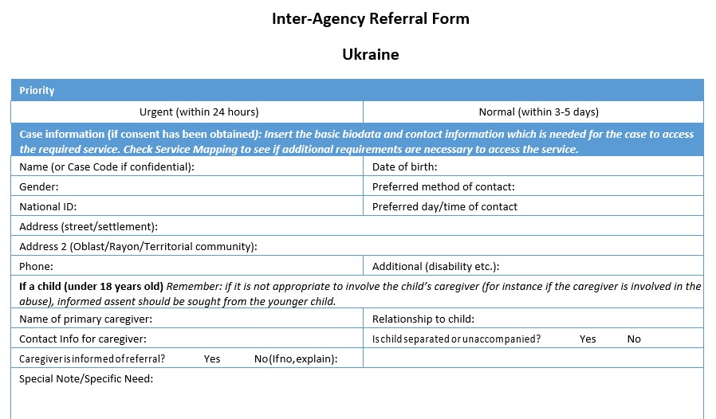
The Inter-Agency Referral Form (part 1)
Notes:
To fill the IRF, the first step will be to identify the priority of the case: is it an urgent need that is immediately life-threatening and requires immediate life-saving assistance? If so, check URGENT. If not, check NORMAL. This will help the person receiving the referral prioritize. In case of uncertainty, when calling the receiver of the referral, see with them if this is considered urgent or not.
Note: the only essential information to have for the referral in this form is the PHONE NUMBER of the person. Do not insist if they do not want to provide the rest of the information. Kindly share this information with the person ahead of filling the form.
For the case information, collect the person’s name, their birthdate, gender and ID if they have it on them, as well as address if they wish, and phone number.
Preferred method of contact can be via phone, email, physical
Preferred day/time of contact, if they have access to a phone only at certain times, if they are working etc.
If you can, indicate whether the person has a specific need, disability, other specific characteristics
If the person is a child, provide the name/contact info/relationship to child of the caregiver UNLESS inappropriate – if the caregiver is part of the protection risk.
Indicate whether the child is separated or unaccompanied. Highlight special note/need if needed

Slide 61
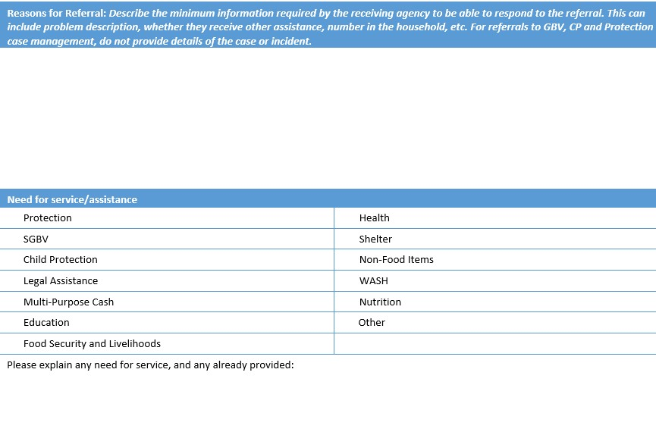
The Inter-Agency Referral Form (part 2)
Notes:
At this stage, we have provided all bio data of the person. We must now indicate why we are referring and to which service.
Reasons for referrals: why does the person need a referral? Describe only the minimum information on the protection need necessary for the referral
Need for service/assistance: What does the person need? highlight for which kind of service you are referring.
If assistance has already been provided (whether for protection or other services), you can add it in the comment section below. This will help the receiver of the referral.
IMPORTANT: we make one referral form for one need! If multiple needs are identified, we have to make separate referral forms for every need.
Remember NOT TO USE this form for GBV.

Slide 62
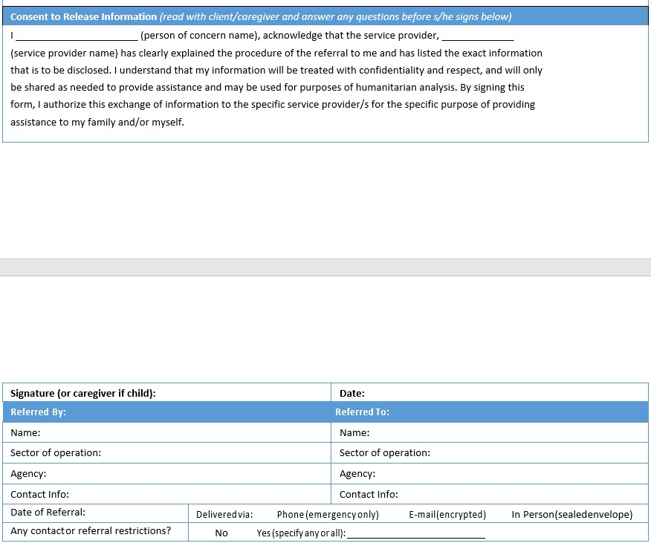
The Inter-Agency Referral Form (part 3)
Notes:
To receive the consent of the person, read them the text and fill in the blanks. Respond to any questions if necessary.
Signature: ask for the person’s signature
Date: include the date of the referral
Referred by: fill in details of your own profile, sector of operation, agency you work for
Referred to: fill in details of the profile of the person you identified to receive the referral, their sector of operation (Protection, Shelter etc.) and their agency and contact info
The last part is for yourself: when you refer the person, fill in the ‘’date of the referral’’. If it is an urgent protection case, the referral date MUST be the same date as the day you collected the information.
Highlight how you delivered the referral. If it is an urgent protection case, you must both CALL and follow-up via email with encrypted IRF.
Any contact or referral restrictions: in case the person has any restrictions.
Do not forget to store this IRF in a safe-place, either in a closet with a key physically, or encrypted on your laptop.

Slide 63
Exercise: filling the IRF
Case study: My name is Natasha. I used to live in XXX with my husband and two year old son, but then the war escalated and he was called to join the Ukrainian forces and fight. I was left alone with my son. We struggled to sleep at night, because of the constant shelling. Until the day, my neighbor’s house was destroyed. We were so scared we left in the middle of the night and walked endlessly until the next day. We heard of this center that we could stay at for the night. We are so scared. We have nightmares every night and barely any food to survive tomorrow.
What needs have you identified following Natasha’s story?
Identify one of the needs, and explain how would you record this information in the IRF
What additional information may you ask that is currently missing in the description of the case?

Slide 64
Step 4
Identify the service provider

Slide 65
The Service Mapping platform
Developed by the Protection Cluster in March 2022
Objectives
  Provide a detailed overview of Protection services
  Including eligibility criteria, access conditions, hotline numbers
  Identify gaps in services and guide Protection Cluster activities
  Support coordination between agencies through referral pathways
  Communicate with communities on services (AAP)
Complemented by Referral Minimum Standards and Inter-Agency Referral Form
Notes:
How do we identify the receiver to whom we should refer the person?
We use the Service Mapping platform, which brings together a detailed overview of all Protection services in Ukraine, including eligibility criteria, access conditions, hotline numbers etc.
It was developed by the Protection Cluster in March 2022 but was launched as a platform in June.
It helps support coordination between agencies through referral pathways, identify gaps in services and guide Protection Cluster activities, and will help communicate with communities.
It is complemented by the Referral Minimum Standards and IRF, so it is not a stand-alone tool, but really a tool to use to facilitate referrals.

Slide 66
Entering and editing your data on the platform
Notes:
The below slides will explain in details how to enter and edit your data on the platform

Slide 67
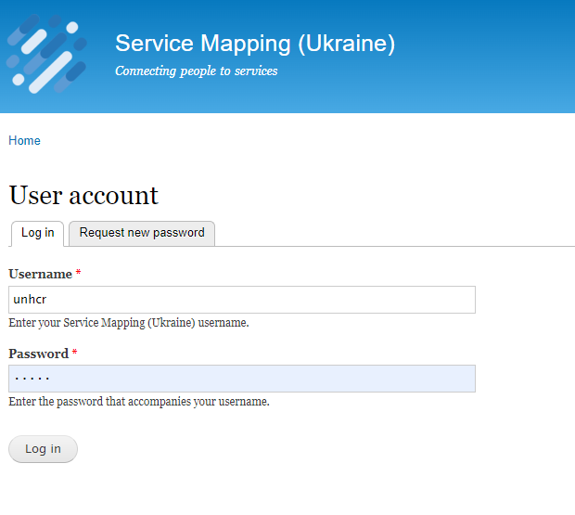
Login page – Ukraine
https://dev.serviceinfo.protectioncluster.org/ukraine/
To access the platform, use the above link.
Each organization will have one focal point.
To request a username, please fill the online matrix shared and inform the protection cluster team to be granted an access. Click here
Enter your Username and Password that you received to login into the system.
If you forgot your password, you can request new one by clicking “Request new password”

Slide 68
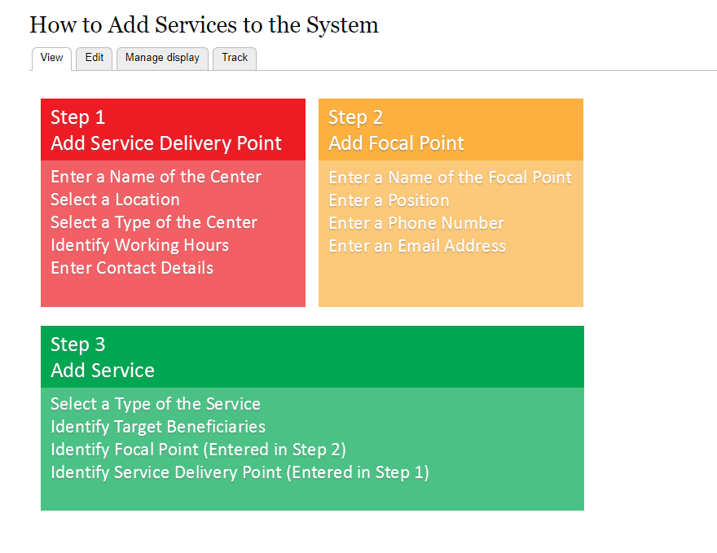
Front page
Once you log in, it will take you to the main screen with some instructions.
There are three main steps you need to complete the registration of a service in the system.
  Step 1: Add the service delivery point
  Step2: Add the organization focal point of your organization.
  Step 3: Add the service your organization is providing.

Slide 69
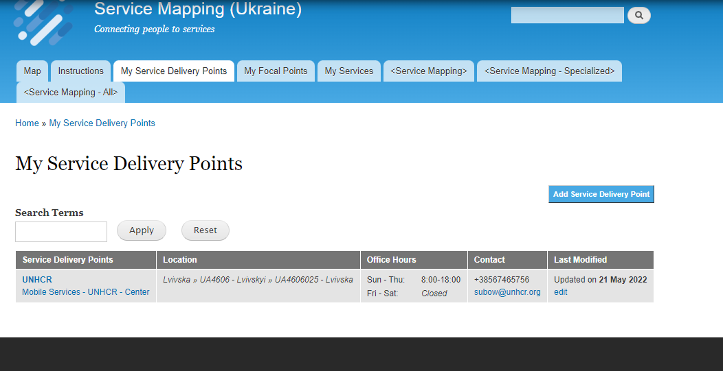
Step 1: Adding Service Delivery point
To add a service delivery point of your organization, you need to:
Click on “ My service Delivery Points”
Click “Add Service delivery point”

Slide 70
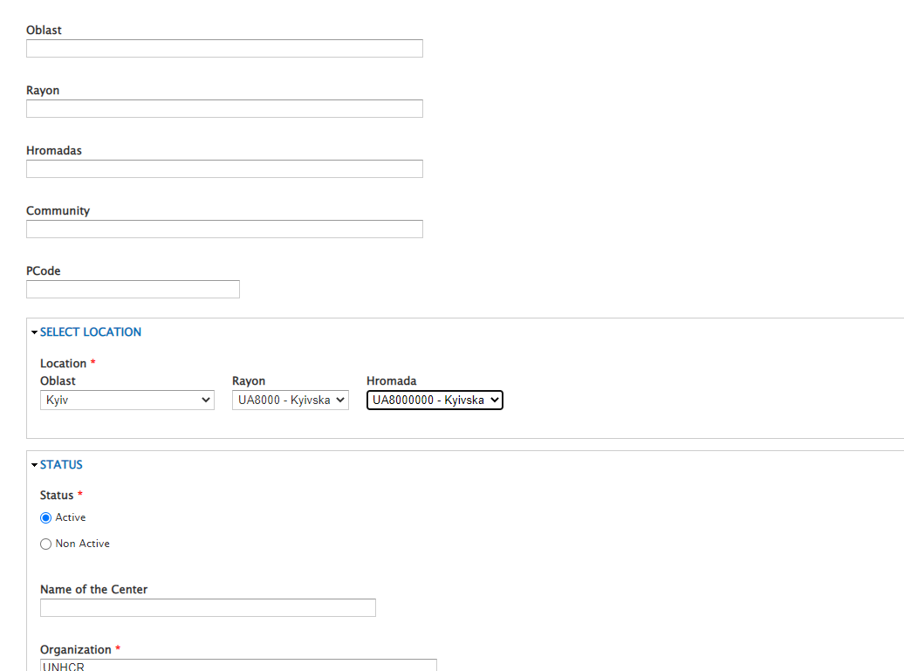
Step 1: Adding Service Delivery point
Add the information of the location, if you can PCODES.
Select from the dropdown list on the name
    Oblast
    Rayon
    Hromada
Add the status of this service delivery point
Add the name of the service delivery point.
The name of your organization.

Slide 71
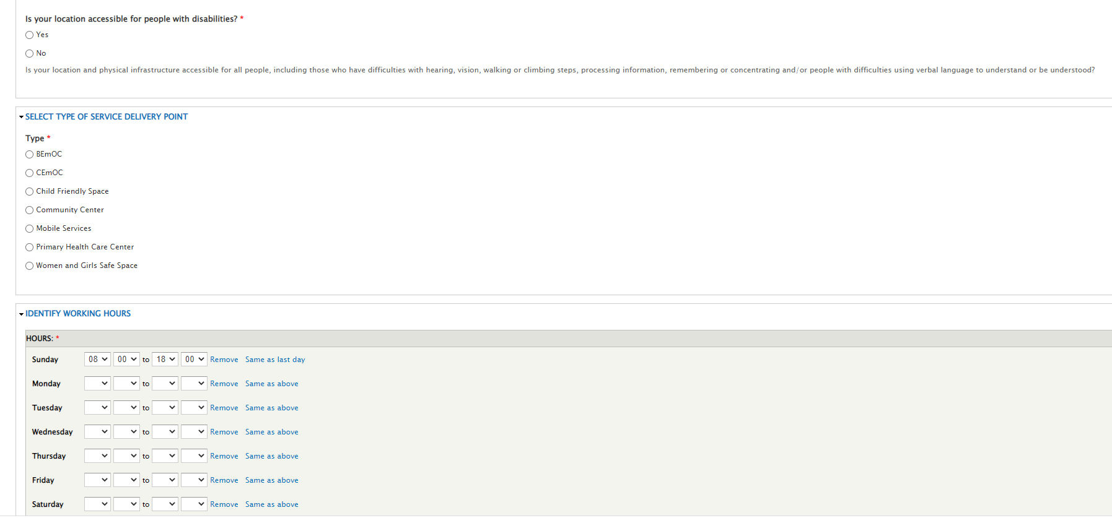
Step 1: Adding Service Delivery point
Add whether the location is accessible to the people with disabilities.
Add the type of service in this location.
Add the working hours of the location, if mobile when the service are accessible

Slide 72
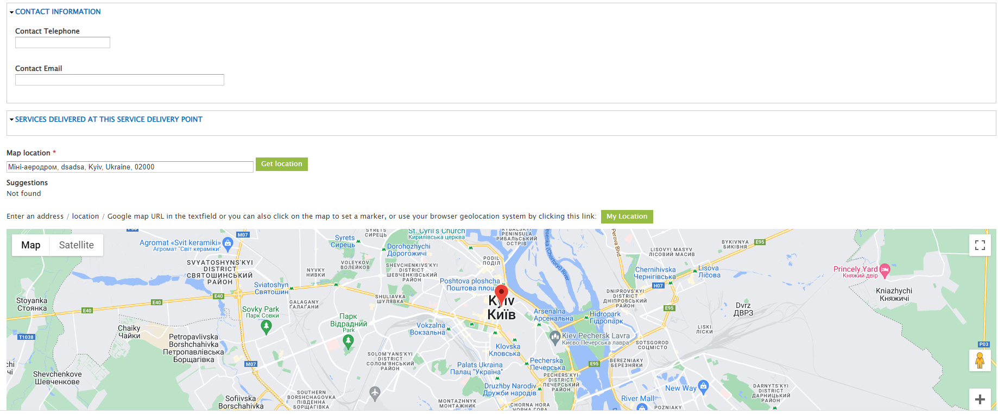
Step 1: Adding Service Delivery point
Lastly, add the location of the service in the map.
  If you are already in the center, click “My location” and it will automatically pick your current location.
  If you are not in the location, you can still add manually.

Slide 73
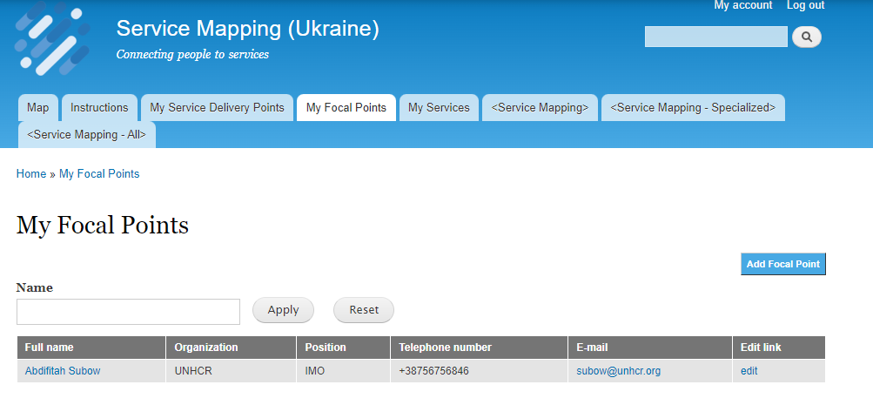
Step 2: Adding your organization focal point
To add your organizational focal point
  In the home page click “My Focal Points”
  Then Select “Add Focal Point”

Slide 74
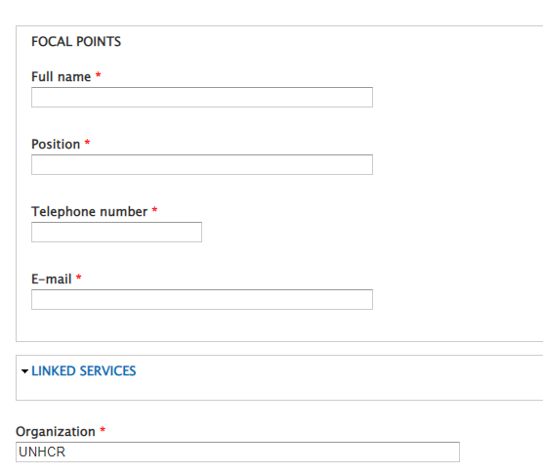
Step 2: Adding your organization focal point
Add your organization focal point details:
Name
Position
Telephone number
Email

Slide 75
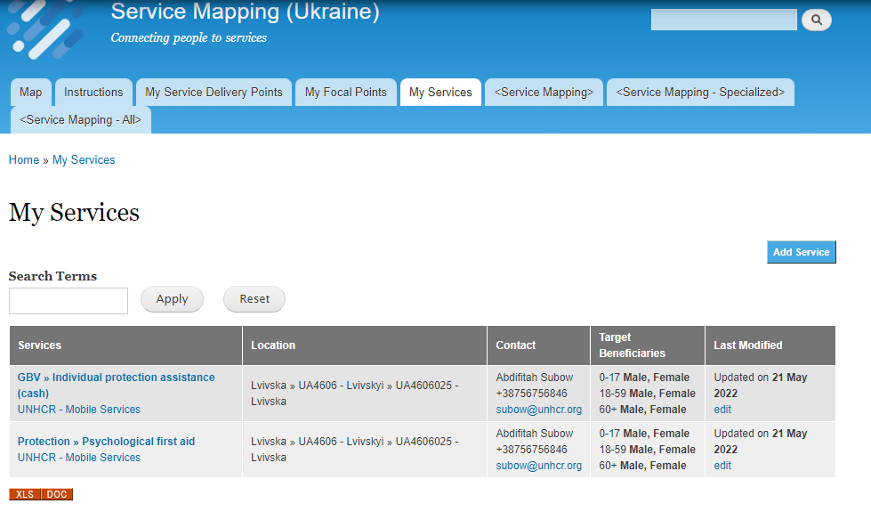
Step 3: Adding your organization Service
To add organization service, you need to follow the below steps.
Click “My service” and view the existing services of your organization.
Click “Add Service” to add a new service.

Slide 76
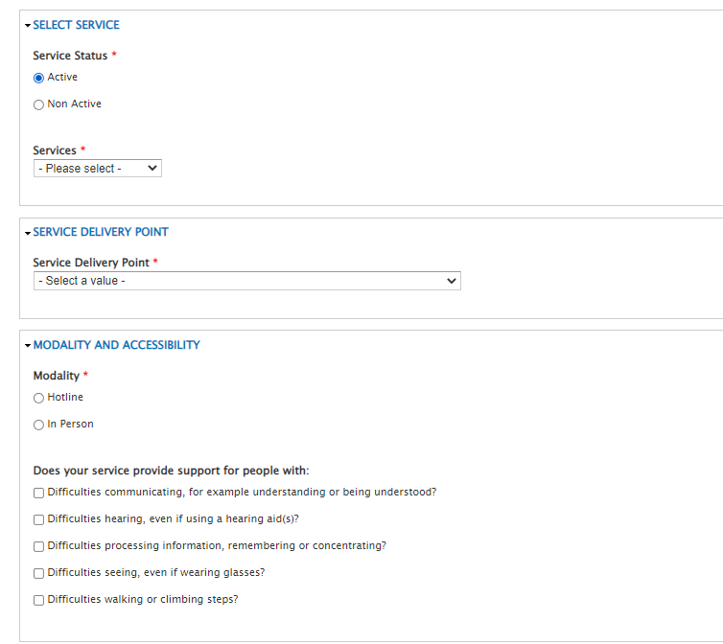
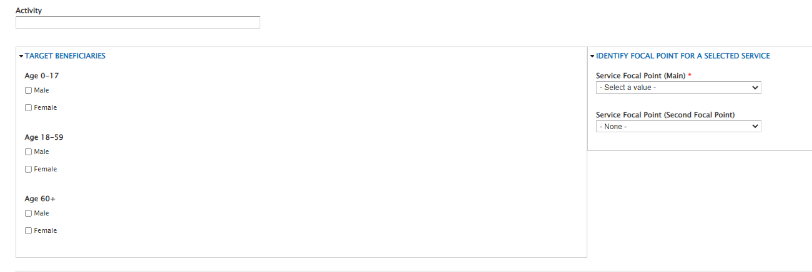
Step 3: Adding your organization Service
Add if the service is currently active and available.
The type of service.
The service delivery point. Refers to step number 1
The modality of service.
Whether the service is available for people with special needs.
The target beneficiaries.
Lastly, the focal point/s for this service.

Slide 77
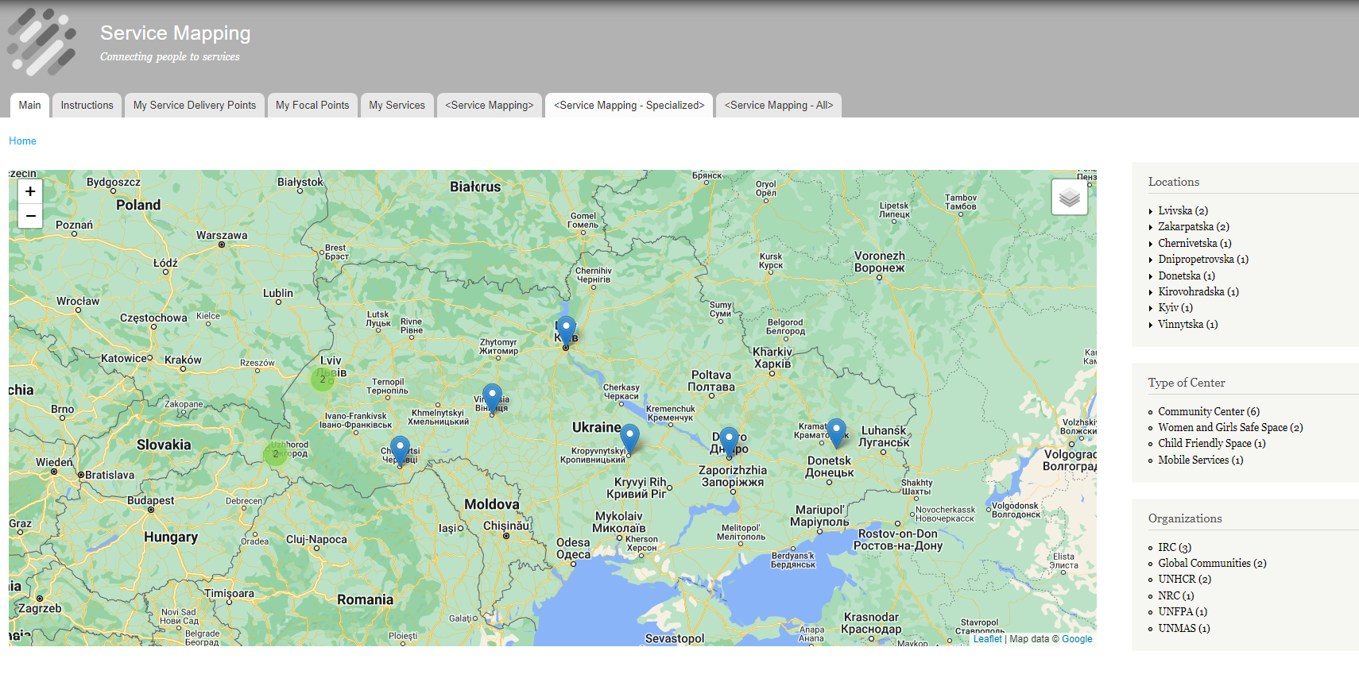
Final product

Slide 78
Using the service mapping platform for referrals
Notes:
Now that service providers’ information has been entered on the platform, the below slides will explain in details how to search for other service providers when conducting referrals

Slide 79


Searching for Protection services
Useful to filter by:
Location
Types of services
Population groups
Find the service provider’s email and phone number

Slide 80
Step 5
Contact the service provider

Slide 81
Sending the referral
For referrals
  Call the person and explain the information in the IRF
  Send the IRF as a follow-up email and encrypted
For re-directions
  Only call the person to pass on the person’s contacts
Remember to track your referral on a personal excel tracking sheet, so you remember that you made it and can follow up appropriately!
Notes:
When sending referrals, always first call the receiving service provider before sending them out the IRF as a follow-up email. The IRF must be sent encrypted.
For re-directions, only pass on the person’s contacts via phone
Remember to track your referrals, so you can remember when you sent it and can follow-up.

Slide 82
Example of a referral tracking sheet
Referral sent/received (DATE) | Referral sent by Agency and person name | Referral sent to Agency and person name | Referral acknowledged (DATE) | Referral Accepted/Not Accepted (DATE) | Comments

Slide 83
Step 6
Follow-up
Notes:
This is a key step of the referral process. The referral process is not finished until the person has received the service.

Slide 84
Statuses when following up on referrals
NO FEEDBACK RECEIVED | REFERRAL ACKNOWLEDGED | REFERRAL ACCEPTED/NOT ACCEPTED
The referral was sent to the service provider, but the service provider did not pick up the phone/respond to the email of the referral | The receiving service provider acknowledged receipt of the referral. They said that the referral is well-received, and that they will now proceed to contact the person in need of the service, to conduct the assessment, and decide whether they can provide the service. | The receiving service provider has conducted the assessment of the person’s Protection need, and come to the conclusion that they can/cannot provide the service.
Notes:
When we follow-up on referrals, we have identified different types of statuses for the referral.
When the referral is sent but there is no response, it has ‘’No Feedback Received’’
When the referral has been received by the receiving agency, it has ‘’Referral Acknowledged’’
When the receiving agency has decided whether or not to provide the service, the referral can be ‘’Accepted’’ or ‘’Not Accepted’’

Slide 85

Following up on referrals
It is the responsibility of the sender of the referral, to follow the process and ensure that the person receives the service
If the receiver of the referral does not respond, the sender of the referral must re-refer the person to another service provider
The receiver of the referral will decide whether to provide the service based on many criteria including prioritization/vulnerability
When sending a referral, it is essential to identify whether the case is urgent or non-urgent
The referral is closed only once the person in need of a service has started to receive that service
Notes:
It is essential to highlight that it is the responsibility of the sender of the referral to make sure that the person eventually receives the service.
If the receiving agency does not provide feedback in a reasonable timeframe/does not accept the referral and service provision, the referring person must re-refer the person to another agency, and that until the person gets the service that they need.
It is important to note that there is generally a huge volume of referrals, and that it is challenging for receivers of referrals to deal with such high volume. So they will need to prioritize the referrals that they can/can’t accept, and that will be often based on vulnerability criteria
Follow-up is influenced by one key factor: urgency of the case. If the person is in urgent need of life-saving service, close follow-up will be required in a short timeframe (24 hours).
The referral is only closed once the person receives the service – not when the person was referred.

Slide 86
On data confidentiality
Referrals in hard copy
Stored in a locked file cabinet if they exist in hard copy in an office
Access to the keys will be limited to the supervisor of case management or the project manager
IRF to be handed over directly to the receiver of the referral in a sealed envelope
Plan for destroying all case information in hard copies in case of an emergency or evacuation
Electronic referrals
Referrals forms should be password protected; the password should be sent to the person again in a separate email/phone call/SMS
Only the humanitarian staff who is the focal point for this service should be copied in the email
Staff interacting with referral data and storage files should sign a data protection agreement
Access to referral forms should be by authorization only and password protected; passwords should be changed regularly
Information about referrals should be kept to a minimum
Data should be anonymized unless absolutely essential to have access to people’s personal information
Staff are informed of the rights of individuals in terms of data collection, storage and sharing of their information
Notes:
Referrals in hard copy
Case forms, referral tracking sheet and inter-agency referrals forms, are to be stored in a locked file cabinet if they exist in hard copy in an office
Access to the keys will be limited to the supervisor of case management or the project manager
The interagency referral form has to be handed over directly to the receiver of the referral (and no other staff in the receiving organization) in a sealed envelope.
Each agency should have a plan in place for destroying all case information in hard copies in case of an emergency or evacuation.
Electronic referrals
Referrals forms should be password protected; the password should be sent to the person again in a separate email/phone call/SMS
Only the humanitarian staff who is the focal point for this service should be copied in the email
Staff interacting with referral data and storage files should sign a data protection agreement
Access to referral forms should be by authorization only and password protected; passwords should be changed regularly
Information about referrals should be kept to a minimum.
Data should be anonymized unless absolutely essential to have access to people’s personal information
Staff are informed of the rights of individuals in terms of data collection, storage and sharing of their information

Slide 87
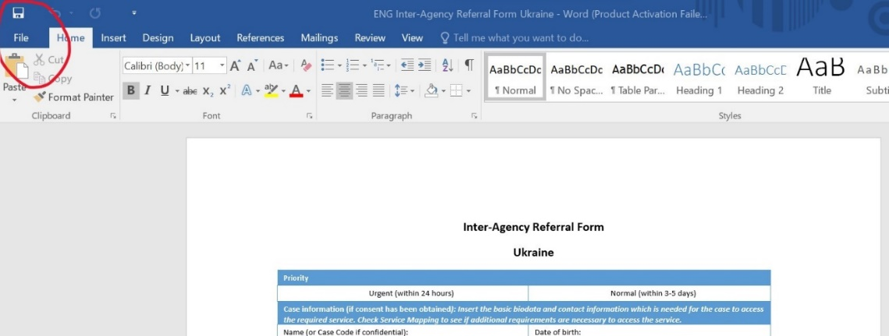
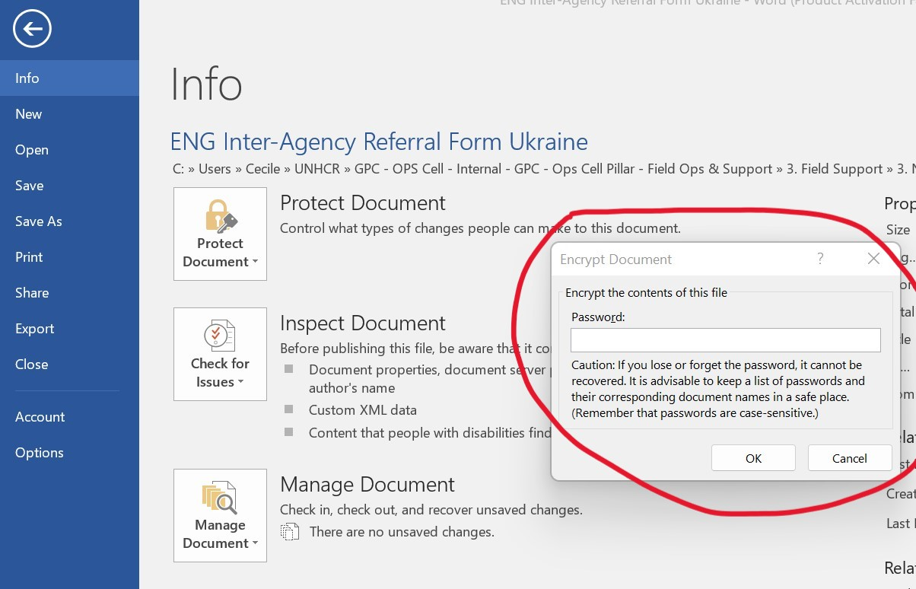
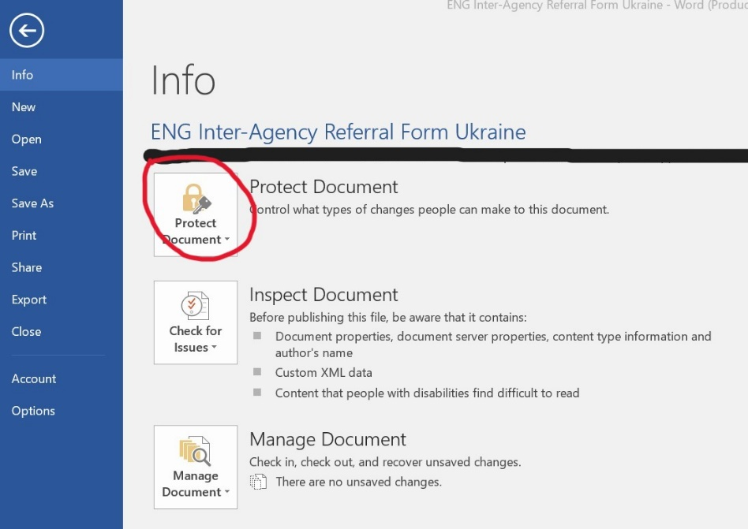
Encryption of excel file
Step 1: Click on ‘’File’’ in your word
document
Step 3: choose ‘’Encrypt file’’ in the dropdown menu and it will open this window. Decide on a password for your file
Step 2: Click on ‘’Protect document’’
Important: send the password in a separate email/text to the receiver
Notes:
Referrals in hard copy
Case forms, referral tracking sheet and inter-agency referrals forms, are to be stored in a locked file cabinet if they exist in hard copy in an office
Access to the keys will be limited to the supervisor of case management or the project manager
The interagency referral form has to be handed over directly to the receiver of the referral (and no other staff in the receiving organization) in a sealed envelope.
Each agency should have a plan in place for destroying all case information in hard copies in case of an emergency or evacuation.
Electronic referrals
Referrals forms should be password protected; the password should be sent to the person again in a separate email/phone call/SMS
Only the humanitarian staff who is the focal point for this service should be copied in the email
Staff interacting with referral data and storage files should sign a data protection agreement
Access to referral forms should be by authorization only and password protected; passwords should be changed regularly
Information about referrals should be kept to a minimum.
Data should be anonymized unless absolutely essential to have access to people’s personal information
Staff are informed of the rights of individuals in terms of data collection, storage and sharing of their information

Slide 88
Referrals in Ukraine
Notes:
Finally, we will look at what are the specific referral pathways in Ukraine to date. This evolves through time, as humanitarian service providers become more organized and tools at Cluster level are being developed, but to date this is where we are at.

Slide 89
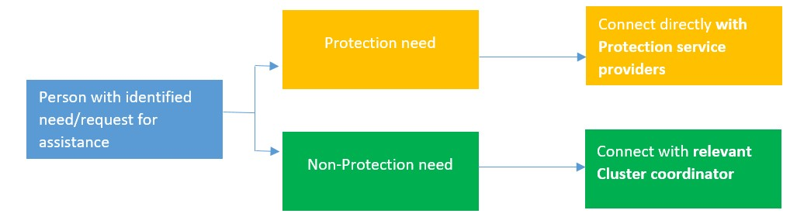
Current
Referral pathways in Ukraine
Remember! The primary receiver of a referral should be the competent authority at local level
Notes:
In Ukraine currently, for referrals to Protection actors, we can directly find them on the Service Mapping platform.
However, for referrals to non-Protection actors, for now, we must contact the relevant Cluster coordinator as there are no harmonized service mapping tool. Unless of course, you know the service provider for WASH, education etc. on the ground directly.
Remember that the primary service providers should always be state social services, unless they are not able to

Slide 90
Protection referral pathways specifics
Call La Strada GBV hotline
0 800 500 225, 116 111
or 1545 (government)
GBV
UA/SC
Contact local child protection service
Protection need
Rehabilitation/
assistive devices
Contact WHO focal point
Volodymyr Golyk
golykv@who.int
All other Protection needs
Look for Protection service provider in Service Mapping
Notes:
For protection specifically, we also have some specific pathways.

