Slide 1
Predictive Model for Protection Risks using Logistic Regression

Slide 2
Predictors and outcome variable
Our outcome variable is a YES / NO, binary variable; Protection Risk on freedom of movement
Afghanistan Protection Monitoring dataset; a household level survey; Q3 data used for the model.
List of predictors (questions)
  Type of site (Rural; Semi Urban; Urban)
  Status of respondent (IDP, Returnee, etc.)
  Age group (Female child 14-17 years, Female adult 18-34 years etc.)
  Marital status ( widowed, divorced, married, single)
  Do you feel safe in your community (yes, no, dnk)
    Reasons men / women do not feel safe (e.g., Harassment and intimidation, community tensions etc.)
  Can you move freely in the area (yes, no, dnk)
    Reasons men / women cannot move freely (e.g., socio-cultural barriers, fear for personal safety etc.)

Slide 3
Logistic Regression

Slide 4

What is Logistic Regression
A statistical modeling technique used to predict the likelihood of a binary outcome based on a set of predictor variables.
In the context of freedom of movement protection risk, a logistic regression model can be developed to identify the factors that increase or decrease the risk of freedom of movement.
Notes:
Logistic regression is useful for when we do not have data for the binary outcome we want to know (in this case, we are assuming we do not have data on freedom of movement). The freedom of movement data we have serves as a “check” to see if our model is correct.

Slide 5
Exploratory Analysis

Slide 6
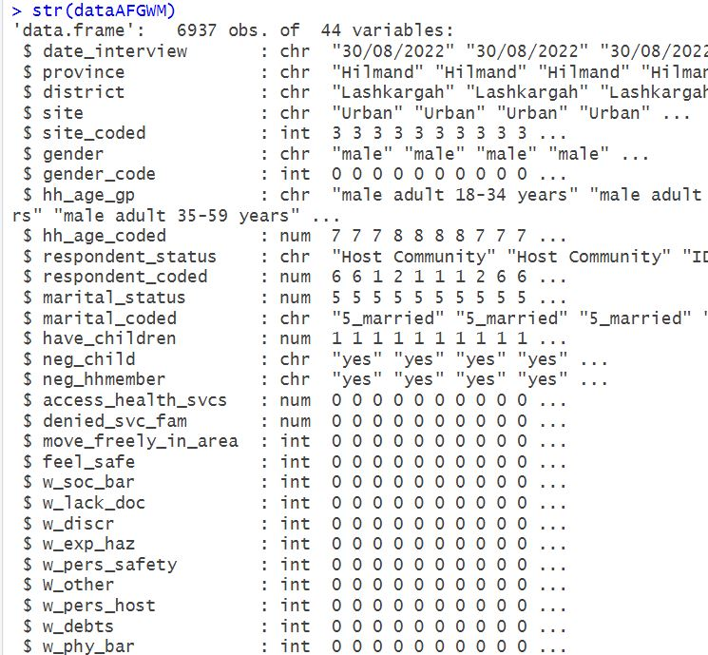
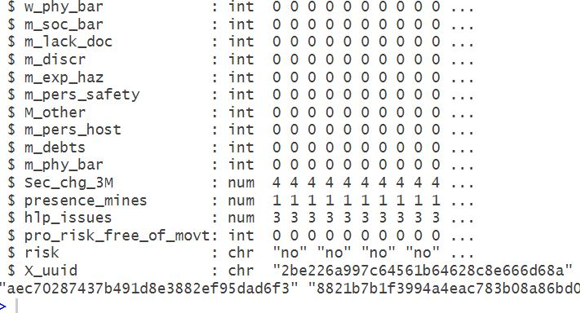
Structure of data
43 predictors
1 outcome variable
6937 records or observations

Slide 7
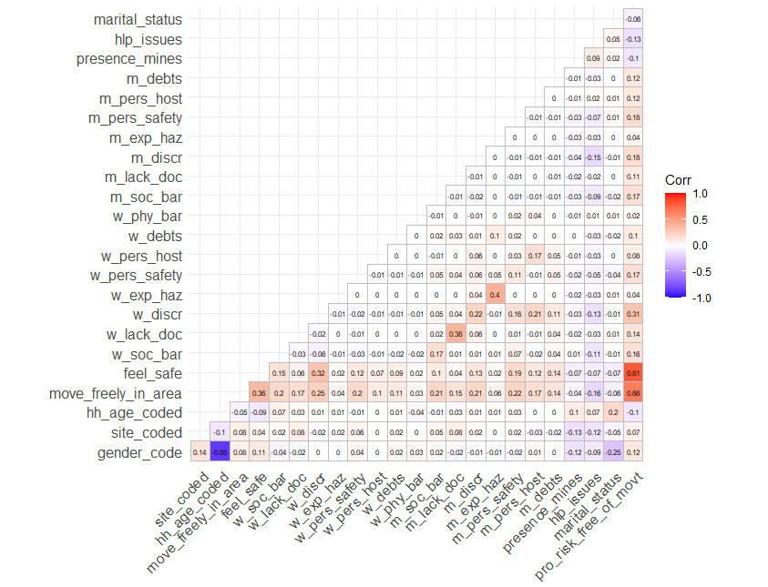
Correlation Matrix
Multicollinearity creates a problem because the inputs are all influencing each other.
Two predictors might be providing the same information about the response variable thereby leading to unreliable coefficients of the predictors.
Notes:
Correlation coefficients whose magnitude are between 0.9 and 1.0 indicate variables which can be considered very highly correlated.
Correlation coefficients whose magnitude are between 0.7 and 0.9 indicate variables which can be considered highly correlated.
Correlation coefficients whose magnitude are between 0.5 and 0.7 indicate variables which can be considered moderately correlated.
Correlation coefficients whose magnitude are between 0.3 and 0.5 indicate variables which have a low correlation.
Correlation coefficients whose magnitude are less than 0.3 have little if any (linear) correlation.

Slide 8
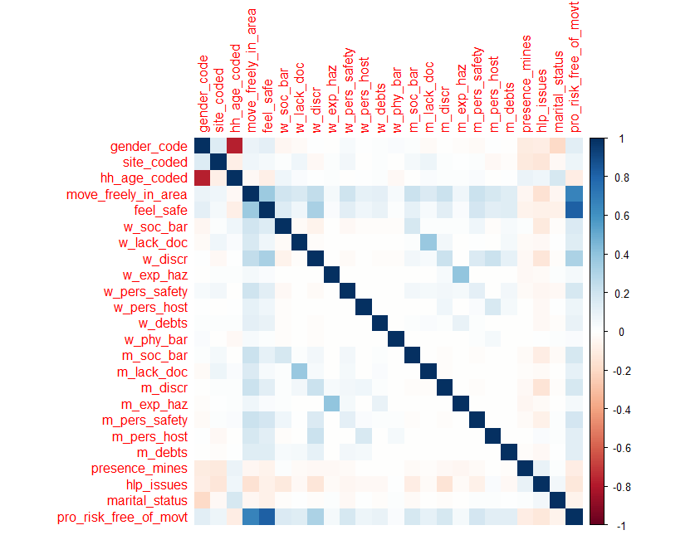
Correlation Matrix another view
Generally variable with highest correlation to the outcome variable is a good predictor.
Notes:
Generally variable with highest correlation is a good predictor. You can also compare coefficients to select the best predictor

Slide 9
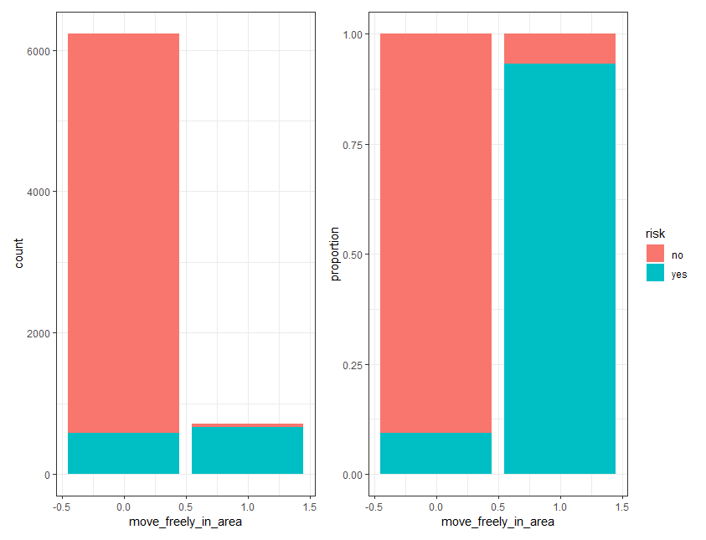
Plot of different variables
High correlation between the “move freely in your area” predictor and the Protection Risk (our outcome variable)
Bar chart: Outcome (protection risk) based on predictor “Can you move freely in the area?”
95%
10%
Notes:
It should be obvious that almost 95% of those who indicated they cannot move freely in their area, compared with those who said they could, faced the freedom of movement protection risk.
10% of those who said they had no issue in moving freely in their area, still ended up facing the “freedom of movement” protection risk.

Slide 10
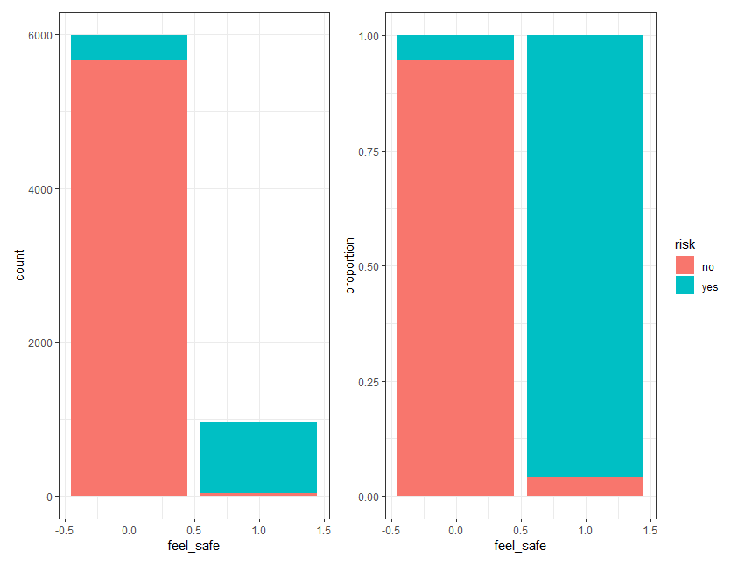
Plot of different variables
High correlation between the “feel safe” predictor and the Protection Risk (our outcome variable)
Bar chart: Outcome (protection risk) based on predictor “Do you feel safe in your community?”
Notes:
We are interested in the association between “feel safe” and occurrence of freedom of movement of protection risk.
To start then, we simply count the number of respondents (Yes / No) who ended up in the YES category of Protection Risk. It is useful to plot this as counts but also as proportions.
We compare proportions but its good to know the absolute numbers (count) as well

Slide 11
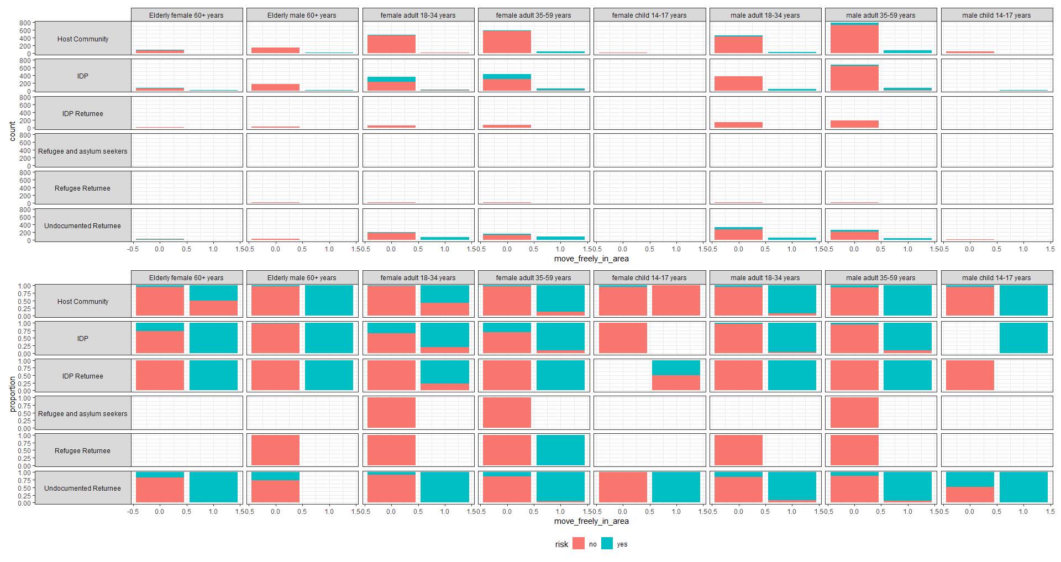
Correlation Matrix
Notes:
Facetted bar plot: Outcome (Protection risk) aggregated by respondent status and different age groups.

Slide 12
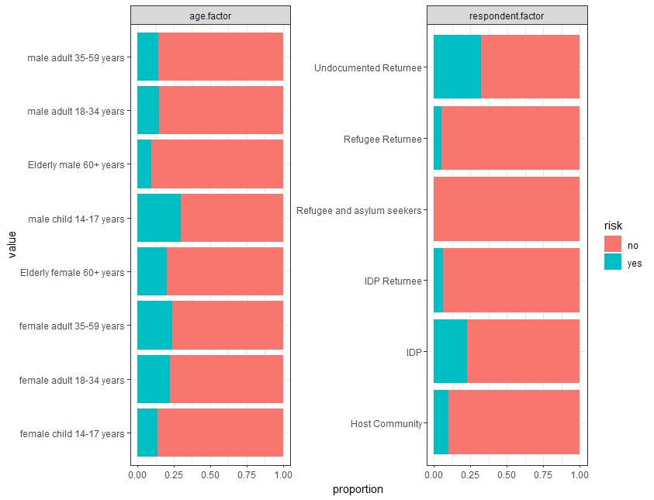
Undocumented returnees and IDPs are more affected
Male child 14-17 years and all the female age groups are affected
Protection Risk by age groups and respondent status

Slide 13
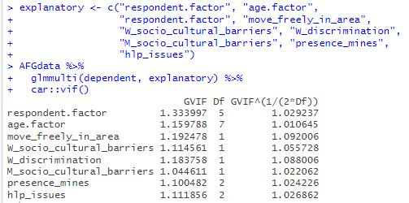
Variance Inflation Factor (VIF)
VIF equal to 1 = variables are not correlated
VIF between 1 and 5 = variables are moderately correlated
VIF greater than 5 = variables are highly correlated
Tool to help identify the degree of multicollinearity
Notes:
A variance inflation factor is a tool to help identify the degree of multicollinearity.
A variance inflation factor (VIF) is a measure of the amount of multicollinearity in regression analysis. Multicollinearity exists when there is a correlation between multiple independent variables in a multiple regression model. This can adversely affect the regression results.

Slide 14
Model Fitting

Slide 15
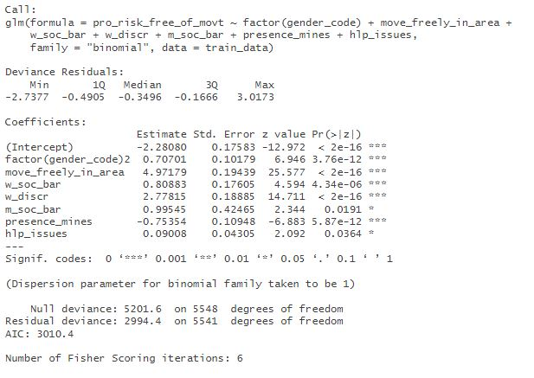
Final fitted model
The factor(gender_code)2 coefficient is positive, indicating that being female is associated with an increase in the log odds of the outcome.
The move_freely_in_area, w_soc_bar, w_discr, and presence_mines coefficients are all positive, and increase our outcome.
The m_soc_bar coefficient is positive but only marginally significant, indicating that increasing m_soc_bar may be associated with a slight increase in the outcome variable.
P value < 0.05
(statistically significant)
Notes:
The intercept term is negative, indicating that when all predictor variables are equal to zero, the log odds of the outcome is negative
Intercept term is negative :e to the power of -2.28080 = 0.10220241207
P = e^{β}₀ ÷ (1 + e^{β}₀) = e^{-2.28} ÷ (1 + e^{-2.28}) = 0.093
0.10220241207 / (0.10220241207+1) = 0.10220241207 / 1.10220241207 = 0.093
The probability that protection risk will occur is 9% for a location where it doesn’t exist before (since our outcome is binary)
The move_freely_in_area, w_soc_bar, w_discr, and presence_mines coefficients are all positive, indicating that increasing the corresponding predictor variables is associated with an increase in the log odds of the outcome.
The m_soc_bar coefficient is positive but only marginally significant, indicating that increasing m_soc_bar may be associated with a slight increase in the log odds of the outcome.

Slide 16
Model Prediction

Slide 17
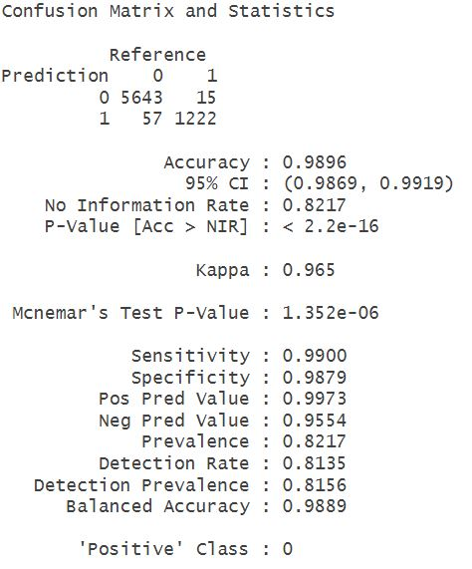
Confusion Matrix
Model accuracy is 98.96%
Notes:
The name comes from the fact that it makes it easy to see whether the system is confusing two classes (i.e. commonly mislabeling one as another).

Slide 18
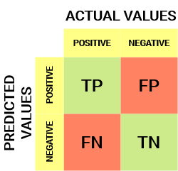
Confusion Matrix
 |  | Actual Values
 |  | NO | YES
Predicted values | NO | 5643 | 15
 | YES | 57 | 1222
The model has predicted No as No, 5643 times and No as Yes, 57 times.
The model has predicted Yes as No, 15 times and Yes as Yes, 1222 times.
The accuracy of the model is 98.96%.

Slide 19
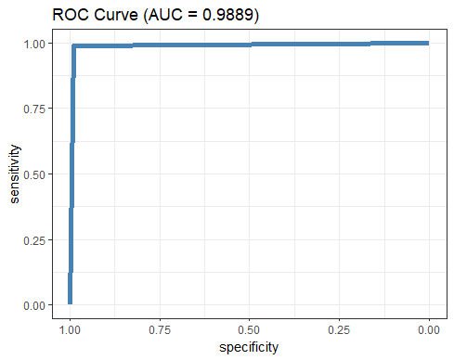
ROC curve
The more ROC curve hugs the top left corner of the plot, the better the model does at classifying the data into categories.
Notes:
An ROC curve (receiver operating characteristic curve) is a graph showing the performance of a classification model at all classification thresholds. This curve plots two parameters: True Positive Rate (y-axis) and False Positive Rate (x-axis)

