Slide 1



The Joint UNHCR-OCHA Note on Mixed Situations
CHILD PROTECTION COORDINATION IN MIXED SETTINGS
SHARING GOOD PRACTICES
The Joint UNHCR-OCHA Note on Mixed Situations
Session #4 - July 19, 2023
Notes:
KARIN
1 minute
<14:01
[Facilitator]: DO [slide 1 – continuation]: When the time is exactly 2pm CET, welcome the participants to this 4th webinar of the online course on CP Coordination in Mixed Settings! Thank participants for joining and indicate your excitement at bringing everyone together again from different locations/operations.
[Facilitator]: DO: Share that the webinar will be recorded so that those who could not attend today also can benefit from the information later. Tell the participants to let the facilitators know in the chat box or bilaterally if they have any concerns about this.
[Facilitator]: DO: Introduce the facilitators’ team in today’s webinar. Invite each facilitator to say a quick hello (waiving in their camera is sufficient). The cameras should be on so the participants can see the facilitator.

Slide 2
SIMILARITIES
Recap: What we know so far
DIFFERENCES
CP systems strengthening
In support of Governments
Attention to most affected groups
Rights based approach
A structured approach to coordination
Coordination responsibilities
Accountabilities
Implications of legal status
Engagement with authorities
Activation / transitioning
Notes:
1 minute
<14:10
Show this slide to conclude 30 sec

Slide 3
Today’s Topics
Coordination in mixed situations
The Joint UNHCR-OCHA Note on Mixed Situations – what, where and how
The six primary points of interface
Notes:
1 minute
<14:11
[Facilitator]: DO [slide 3]: Build upon the participants’ input to the warm-up question as you go through the session agenda:
Recap – what we know so far, and opportunity for Q&A
The Joint Note – what, where and how
Coordination in practice: The six primary points of interface
[Facilitator]: SAY: “As we mentioned last time, the webinar needs us all to work as a team. For this reason, we would like you to stay with us for the full webinar (120 minutes); participate active (verbally, chat, emoticons) and, if possible, keep your cameras on. There are no right or wrong answers, or silly questions. Let’s embrace this moment we have to explore how we can ensure even better the protection of children, which is the ultimate reason why we are here.”

Slide 4
Quick Poll
How do you feel about the Joint UNHCR-OCHA Note on Mixed Situations?
I have read it and it’s clear to me
I have read it and it is to some extent clear
It is not clear / it is confusing
I didn’t read it (yet!)
Notes:
2 minutes
<14:13
Teams poll
How do you feel about the Joint UNHCR-OCHA Note on Mixed Situations?
I have read it and it’s clear to me
I have read it and it is to some extent clear
It is not clear / it is confusing
I didn’t read it (yet!)

Slide 5



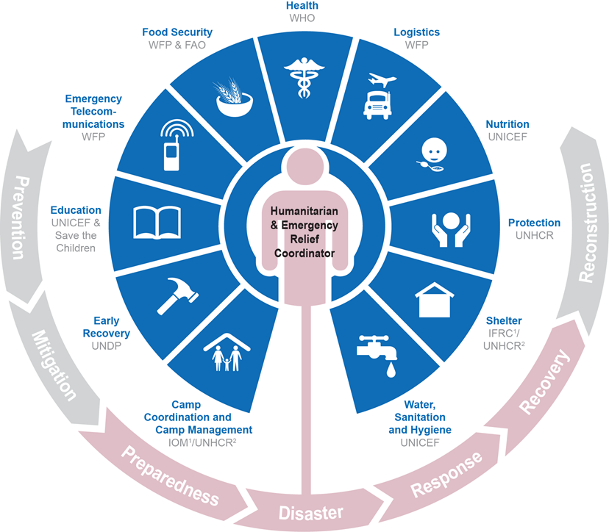

Mixed settings
Internally Displaced Populations
Refugee Populations
Other
Epidemics
Notes:
NOURA
1 minutes
<14:14
Set the scene – today we are getting into CP coordination in mixed settings.
We have learnt about Cluster coordination and RCM in the two previous webinars.
What do we know so far? Let’s have a look at a few points, and as we go through, please note down any pending questions you may have – then we’ll have time for Q&A.

Slide 6







What is a mixed setting?
Where refugees are present in the country in a separate geographic area from IDPs and other affected population
Where refugees are present in the same geographic area as IDPs and other affected population
Notes:
NOURA
5 minutes
<14:19
Use the slide to present what mixed setting is and the relevance of this session/topic.

Slide 7
WHY
Ensure that coordination is streamlined, complementary and mutually reinforcing, and to avoid duplication at the delivery level.
Sets out the respective accountabilities, roles and responsibilities of the Humanitarian Coordinator and UNHCR Representative in contributing to IASC agreed strategic outputs of coordination.
Clarifies the leadership and coordination arrangements.
WHERE
A Humanitarian Coordinator has been appointed to lead and coordinate humanitarian action and where refugees are present in a separate geographic area from IDPs and other affected populations;
A Humanitarian Coordinator has been appointed to lead and coordinate humanitarian action and where refugees are present in the same geographic area as IDPs and other affected populations.
WHO
The High Commissioner/UNHCR Representative and the Emergency Relief Coordinator/Humanitarian Coordinator will consult and reach mutual agreement on the best option.
Regardless of which mechanism (i.e. IASC Clusters or UNHCR Sectors) is utilised, the respective accountabilities of the Humanitarian Coordinator and the UNHCR Representative remain unchanged.
Notes:
NOURA
8 minutes
<14:27
History and background:
The objectives for the Joint Note (WHY)
The context in which the Note applies (WHERE)
Who decide on the coordination arrangements (WHO)
What are the key points of interface? (WHAT)
UNHCR and OCHA issued the Joint UNHCR – OCHA Note on Mixed Situations: Coordination in Practice on 24 April 2014 and three subsequent joint letters (29 September 2015 / 2 September 2016 / 5 June 2018, see annex) stating the respective accountabilities, roles and responsibilities of the Humanitarian Coordinator and UNHCR Representative in mixed situations (where the populations of humanitarian concern include refugees, IDPs, and other affected groups).
Imagine the scenarios we just discussed where we have IDPs and refugees in the same country/location. Instead of spending time asking who will do what, what is the role, who is responsible, or debating mandate or accountabilities, the Note aims to ensure that coordination arrangements are streamlined, complementary and mutually reinforcing. An objective is also to minimise duplications at the delivery level and to have a common understanding of the needs.
The note also helps us to set out the respective accountabilities, roles and responsibilities of the Humanitarian Coordinator and UNHCR Representative (who oversee the cluster coordination and the refugee coordination systems) in contributing to IASC agreed strategic outputs of coordination.
So, in other words, it clarifies the leadership and coordination arrangements in the situation where a complex humanitarian emergency or natural disaster is taking place, a Humanitarian Coordinator has been appointed, and a UNHCR led refugee operation is also underway. It describes how leadership and coordination mechanisms should function in practice.
The note covers two contexts:
Where a Humanitarian Coordinator has been appointed to lead and coordinate humanitarian action and where refugees are present in a separate geographic area from IDPs and other affected populations;
Where a Humanitarian Coordinator has been appointed to lead and coordinate humanitarian action and where refugees are present in the same geographic area as IDPs and other affected populations.
Connect back to the warm-up exercise where the particpants indicated in which type of setting they work.
Who is responsible at country and global level:
The High Commissioner/UNHCR Representative and the Emergency Relief Coordinator/Humanitarian Coordinator will consult and reach mutual agreement on the best option. This will be context specific depending on the needs among displaced people but also the political landscape that has to be carefully analysed.
The Note is also emphasising that regardless that of which mechanism is utilised (i.e. IASC Clusters or UNHCR Sectors), the respective accountabilities of the Humanitarian Coordinator and the UNHCR Representative remain unchanged.

Slide 8
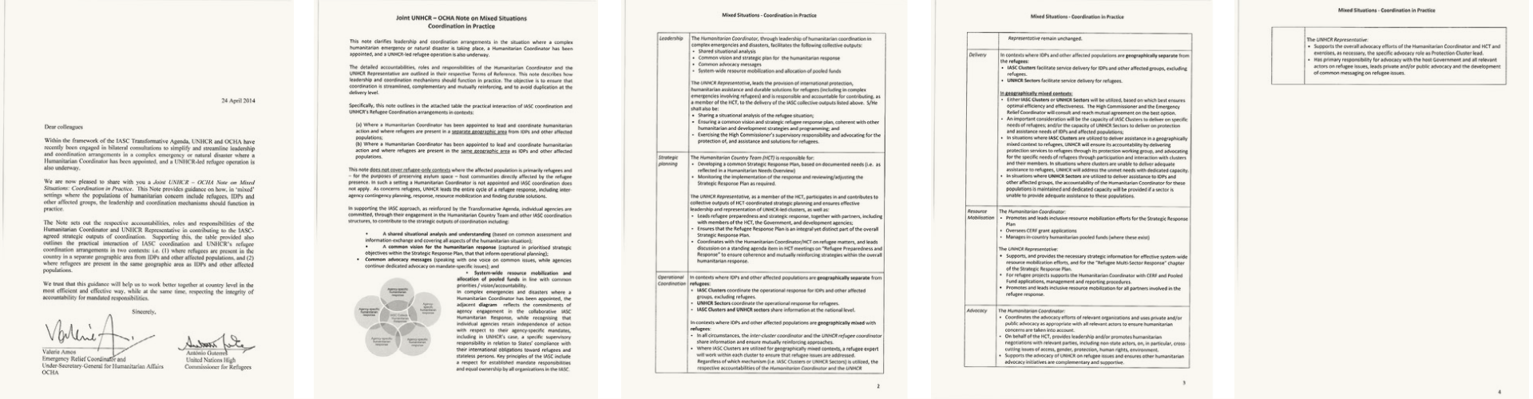
Joint UNHCR / OCHA Note on Mixed Situations – Coordination in practice
Leadership
Strategic planning
Delivery
Collective outputs of coordination
Advocacy
Operational coordination
Resource mobilisation
Notes:
NOURA
3 minutes
<14:30
There is a last W after the why, where and who which is the WHAT.
This is a quick overview of how the Note looks like.
The Note has six primary points of interface: Leadership, Strategic planning, operational coordination, delivery, resource mobilization and advocacy.
We will now look at the different sections of the joint note in detail, starting with the definition of collective outputs for coordination

Slide 9
Collective outputs of coordination
Shared situational analysis and understanding
Common vision for the humanitarian response
Common advocacy messages
System-wide resource mobilisation and allocation of pooled funds
Notes:
NOURA
10 minutes
<14:40
For the purpose of the note, the key collective outputs that contribute to IASC coordination outputs have been identified. These are four outputs, regardless of the population being in the same location or separate location. At the national level, the Cluster system and the Refugee Coordination Model should achieve:
A shared situational analysis and understanding [based on common assessment and information-exchange and covering all aspects of the humanitarian situation].
A common vision for the humanitarian response [captured in prioritised strategic objectives within the Strategic Response Plan, that that inform operational planning].
Common advocacy messages [speaking with one voice on common issues, while agencies continue dedicated advocacy on mandate-specific issues]; and
System-wide resource mobilisation and allocation of pooled funds in line with common priorities/ vision/ accountability.
Shared SitAN - what does it mean for CP? Give examples from your experience. If you don’t have a good example, how do you THINK it could be done.

Slide 10
Leadership
Humanitarian
Coordinator
UNHCR
Representative
Leads the humanitarian coordination in complex emergency and disasters.
Facilitates the collective outputs:
Shared situational analysis and understanding
Common vision for the humanitarian response
Common advocacy messages
System-wide resource mobilisation and allocation of pooled funds
Leads the provision of international protection, assistance and solutions for refugees, including in complex emergencies.
Contributes to the collective HCT outputs &:
Shares situational analysis of refugee situation
Ensures a common vision and strategic refugee response plan
Supervisory responsibility and advocacy for protection/assistance/solutions for refugees
Notes:
ERIC
8 minutes
<14:48
Remember the collective outputs that we just spoke about
Shared situational analysis and understanding
Common vision for the humanitarian response
Common advocacy messages
System-wide resource mobilisation and allocation of pooled funds
The humanitarian coordinator is the one who facilitates these collective outputs at national level.
The UNHCR Representative is contributing to these outputs. Also, because of the mandate, the UNHCR Representative is responsible for the SitAn of the refugee situation and that there is a common vision and strategic refugee response. (Remind the participants that UNHCR’s mandate is non-transferable). The UNHCR Representative also has a supervisory responsibility and advocacy responsibility for protection, assistance and solutions for refugees.
Reflections? Is this visible in your contexts?
Check the exact wordings: https://www.unhcr.org/media/joint-letter-unhcr-ocha-transformative-agenda

Slide 11
Strategic planning
Humanitarian Coordinator
UNHCR Representative
Develops the Humanitarian Response Plan (HRP) based on identified needs in the HNO.
Monitors and adjusts humanitarian response.
Contributes to HRP and ensures leadership and representation of UNHCR led clusters.
Leads refugee preparedness and response planning.
Ensures Refugee Response Plan it is an “integral yet distinct” part of the HRP.
Coordinates with Humanitarian Coordinator and the HCT on refugee matters.
Notes:
ERIC
8 minutes
<14:56
Humanitarian coordinator
Develops the Humanitarian Response Plan (HRP) based on identified needs in the HNO.
Monitors and adjusts humanitarian response.
UNHCR Representative:
As a member of the HCT, contributes to HRP and ensures leadership and representation of UNHCR led clusters
Leads refugee preparedness and response planning
Ensures Refugee Response Plan it is an “integral yet distinct” part of the HRP
Coordinates with HC/HCT on refugee matters to ensure mutually reinforcing strategies within the overall humanitarian response
Check the exact wordings: https://www.unhcr.org/media/joint-letter-unhcr-ocha-transformative-agenda

Slide 12
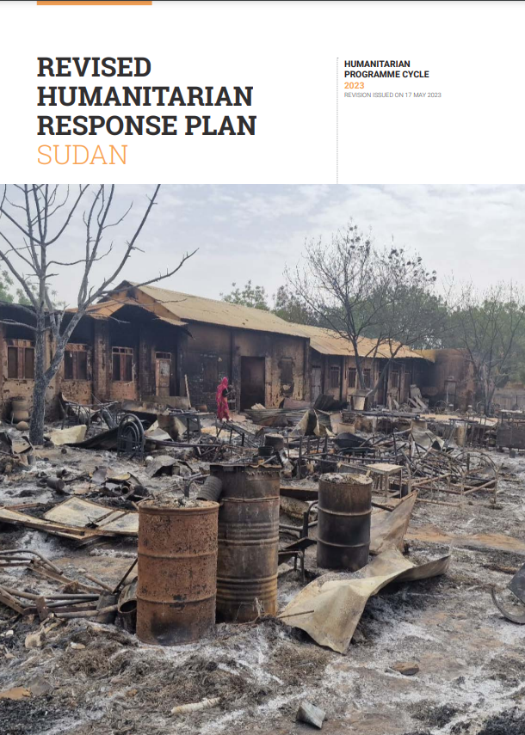
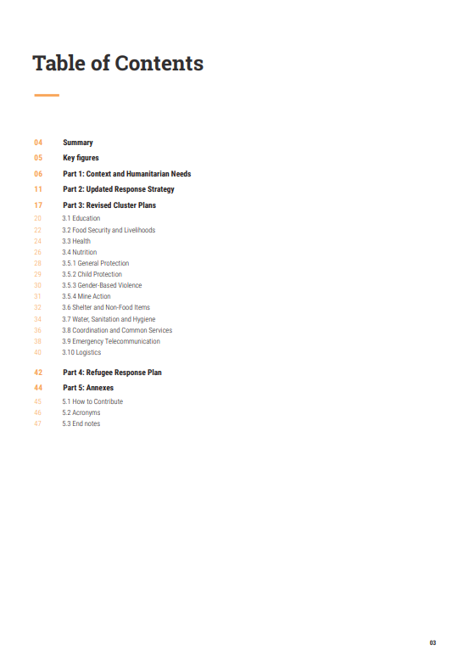
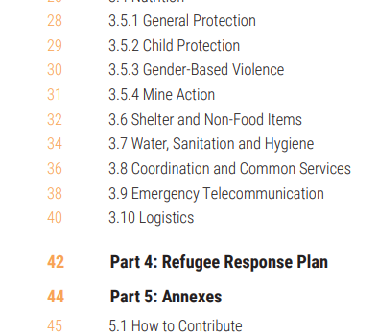
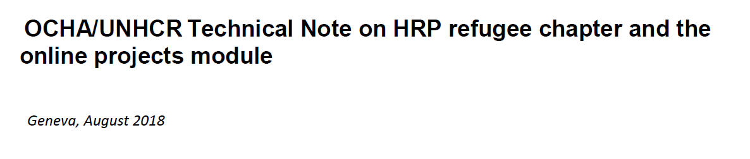

Strategic planning – an example
Notes:
Noura
2 minutes
<14:58
OCHA coordinates the preparation, implementation, monitoring and reporting of the country Humanitarian Response PlanThe Refugee Response Plan is an integral yet distinct part of the overall HRP.
UNHCR leads the refugee response and coordinates the development of the HRP refugee chapter. The refugee response may also be presented in separate plans issued by UNHCR such as Country and Regional Refugee Response Plans (RRPs).
Presenting the refugee response in the HRP template
The Refugee Response Plan chapter presents the narrative, financial requirements, target population, objectives, indicators and targets related to refugees.
In addition, the financial requirements and the caseloads pertaining to refugees corresponding to specific sectors will be reflected throughout the HRP document.
This is the HRP from Sudan and as you can see it has a chapter on refugee.

Slide 13
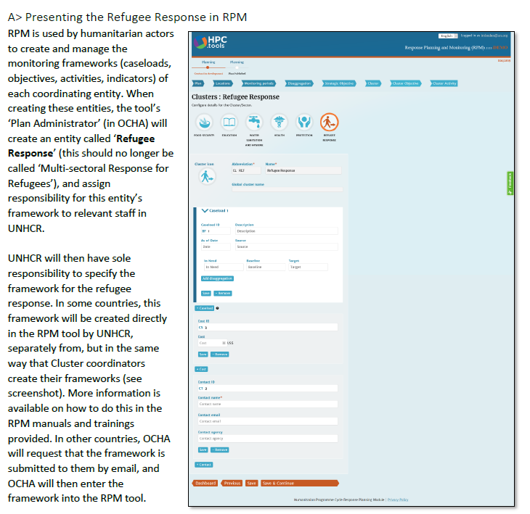
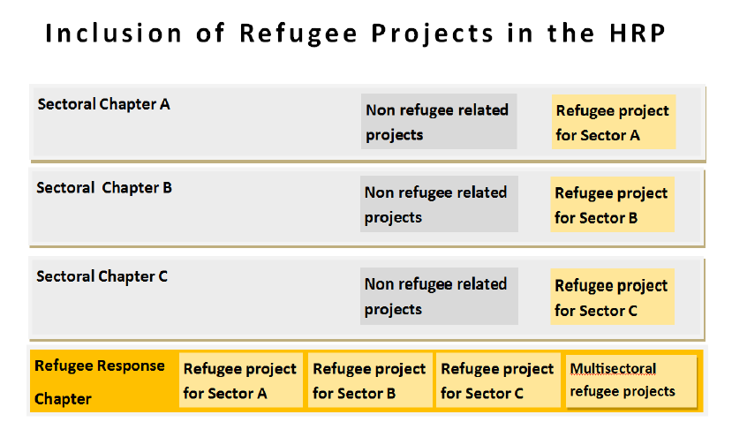
OCHA/UNHCR Technical Note on HRP Refugee Chapter and the Online Projects Module
Source: https://reliefweb.int/report/world/ochaunhcr-technical-note-hrp-refugee-chapter-and-online-projects-module
Notes:
NOURA
2 minutes
<15:00
There is a tool available called OCHA/UNHCR Technical Note on HRP Refugee Chapter and the Online Projects Module.
Ask participants if they have heard about it? Who has used it, raise a thumbs up. Invite them to elaborate – what is it and how was it used?
The 3 pager UNHCR / OCHA technical note clarifies how the Joint Note on mixed settings translate into the HRPs process at field level. It facilitates the process of ensuring that the refugee response is integrated in the HRP is integrated based on technical standards.
Explain the image to the left:
The yellow markings vertically: Shows that refugee projects are crosscutting different sectoral chapters.
The yellow markings horizontally: Shows the specific Refugee Response Chapter, and the refugee projects for sector A, B, C etc.
Explain the image to the right:
In addition, the note explains in detail how to register the refugee response in the HPC.tools Response Planning Module (RPM) and refugee projects in the HPC.tools Projects Module (new OPS).
https://reliefweb.int/report/world/ochaunhcr-technical-note-hrp-refugee-chapter-and-online-projects-module
Q&A before the break

Slide 14
Break - 5 minutes ☺
Notes:
<15:05

Slide 15
Operational Coordination and Delivery
In different locations within the same country
In same locations within the same country
Notes:
JOYCE
5 minutes
<15:10
We will now enter into how to decide on the coordination mechanism at the field level. Two distinctions:
If refugees are in a different place from IDPs and other affected populations (i.e. separate geographic area). On the slide to the left we can see refugees residing in a camp and IDPs and other affected populations also living in country B.
If IDPs, refugees and other affected populations are present in the same geographic area. We can see this on the slide to the right.
Let’s start with zooming in on ”Operational Coordination” which was one of the six primary points of interface.

Slide 16
Operational Coordination
In different locations within the same country
In same locations within the same country
AND
OR
IASC clusters coordinate the response for IDPs and other affected groups (excluding refugees).
UNHCR sectors coordinate the response for refugees.
The inter cluster coordinator and the UNHCR refugee coordinator share information and ensure mutually reinforcing approaches.
Where IASC clusters are used, a refugee expert will work within each cluster.
They share information at the national level.
Notes:
JOYCE
10 minutes
<15:20
At national level, no change happens in the system – they both remain the same.
At subnational level:
In contexts where IDPs and other affected populations are geographically separate from refugees (as illustrated by the models on the left side of the slide):
IASC Clusters coordinate the operational response for IDPs and other affected groups, excluding refugees.
UNHCR Sectors coordinate the operational response for refugees.
In other words, the full application of both systems in two different areas of the country. From sub-national level, information is shared to the national level.
IASC Clusters and UNHCR sectors share information at the national level.
In contexts where refugees are present in the same geographic area as IDPs and other affected populations (as illustrated by the models on the right side of the slide):
The applied system will depend on the context and what is most suitable according to analysis and validation of this analysis.
In all circumstances, regardless of the system applied, the inter-cluster coordinator and the UNHCR refugee coordinator share information and ensure mutually reinforcing approaches.
Where IASC Clusters are utilised, a refugee expert will work within each cluster to ensure that refugee issues are addressed.
Regardless of which system is utilised, the respective accountabilities of the Humanitarian Coordinator and the UNHCR Representative remain unchanged.
Time for discussion:
Which system is applied at the sub-national level where you work? What are the coordination arrangements and who facilitates service delivery?
How does this “translate” into effective child protection coordination and service delivery?
What works?
What could be done differently/better?
Conclude: Determining the most appropriate coordination arrangement is done through analysis of the context.
Targeted population, e.g. who they are, their profile?
Complexity of the context, e.g. numbers, issues?
Who are we trying to serve?
What is the existing capacity?
The political context, e.g. what are the risks and benefits with one system supporting the other; one system providing support to all populations affected.

Slide 17
Delivery
In different locations within the same country
In same locations within the same country
AND
OR
IASC clusters facilitate service delivery for IDPs and other affected groups (excluding refugees).
UNHCR sectors deliver protection and assistance for refugees and host community.
Either IASC Cluster or UNHCR Sectors will be utilised based on the HC and UNHCR Representative agreement
Where IASC clusters are utilised to deliver assistance to refugees, UNHCR delivers protection services to refugees through its protection working group and advocates for the needs of refugees.
Where UNHCR sectors are utilised to deliver assistance to IDPs and other affected populations, the accountability of the HC for IDPs and other populations is maintained.
Notes:
JOYCE
10 minutes
<15:30
Let’s now zoom in on ”Delivery” which was one of the six primary points of interface.
In contexts where IDPs and other affected populations are geographically separate from the refugees (as illustrated by the models on the left side of the slide):
IASC Clusters facilitate service delivery for IDPs and other affected groups, excluding refugees.
UNHCR Sectors facilitate service delivery for refugees.
In contexts where refugees are present in the same geographic area as IDPs and other affected populations (as illustrated by the models on the right side of the slide):
Either IASC Clusters or UNHCR Sectors will be utilised, based on which best ensures optimal efficiency and effectiveness. The High Commissioner and the Emergency Relief Coordinator will consult and reach mutual agreement on the best option.
An important consideration will be the capacity of IASC Clusters to deliver on specific needs of refugees; and/or the capacity of UNHCR Sectors to deliver on protection and assistance needs of IDPs and affected populations;
In situations where IASC Clusters are utilised to deliver assistance to refugees, UNHCR will ensure its accountability by delivering protection services to refugees through its protection working group and advocating for the specific needs of refugees through participation and interaction with clusters and their members. In situations where clusters are unable to deliver adequate assistance to refugees, UNHCR will address the unmet needs with dedicated capacity. UNHCR’s mandate and accountabilities cannot be transferred.
In situations where UNHCR Sectors are utilised to deliver assistance to IDPs and other affected groups, the accountability of the Humanitarian Coordinator for these populations is maintained and dedicated capacity will be provided if a sector is unable to provide adequate assistance to these populations.
So, to conclude, no matter which system is applied, there should not be any gap in service delivery. The accountabilities of each system remains the same.

Slide 18
Resource mobilisation
Humanitarian Coordinator
UNHCR Representative
Leads resource mobilisation efforts for the Humanitarian Response Plan.
Oversees CERF Grant applications.
Manages in country pooled funds (if any).
Supports strategic information for effective system wide resource mobilisation.
Supports the HC with CERF and pooled funds process for refugee projects.
Leads inclusive resource mobilisation for all partners involved in the refugee response.
Notes:
NOURA
10 minutes
<15:40
Now we’ll go back to the national arrangements. Remind the participants that one of the key collective outputs that we saw earlier was “System-wide resource mobilisation and allocation of pooled funds in line with common priorities/ vision/ accountability.”
The humanitarian Coordinator
Leads resource mobilisation efforts for the Humanitarian Response Plan
Oversees Central Emergency Response Fund (CERF) Grant applications
Manages in country pooled funds (if any)
The UNHCR Representative:
Supports, and provides the necessary strategic information which allows for effective system-wide resource mobilisation efforts, and for the “Refugee" chapter of the Humanitarian Response Plan.
Supports the HC with CERF and pooled funds process for refugee projects fund applications, management and reporting procedures.
Promotes and leads inclusive resource mobilization for all partners involved in the refugee response.

Slide 19
Advocacy
Humanitarian Coordinator
UNHCR Representative
Coordinates the advocacy efforts.
On behalf of HCT, leads advocacy and / or promotes humanitarian negotiations.
Supports the advocacy of UNHCR on refugee issues and ensure other advocacy efforts are complementary and supportive.
Supports advocacy efforts of the HC/HCT and exercises advocacy role as protection cluster lead.
Has primary responsibility for advocacy with host government on refugee issues and leads advocacy on refugee issues.
Notes:
ERIC
10 minutes
<15:50
The last primary point of interface is advocacy. Remind the participants that one of the key collective outputs that we saw earlier was “Common advocacy plana and messages [speaking with one voice on common issues, while agencies continue dedicated advocacy on mandate-specific issues].”
Important to send out the same message, be stronger and avoid confusion.
The Humanitarian Coordinator:
Coordinates the advocacy efforts of relevant organisations and uses private and/or public advocacy as appropriate with all relevant actors to ensure humanitarian concerns are taken into account.
On behalf of the HCT, provides leadership and/or promotes humanitarian negotiations with relevant parties, including non-state actors, on, in particular, cross- cutting issues of access, gender, protection, human rights, environment.
Supports the advocacy of UNHCR on refugee issues and ensures other humanitarian advocacy initiatives are complementary and supportive. (This is very important and sends a strong message of collaboration and reinforcing each others’ efforts).
The UNHCR Representative:
Supports the overall advocacy efforts of the Humanitarian Coordinator and HCT and exercises, as necessary, the specific advocacy role as Protection Cluster lead.
Has primary responsibility for advocacy with the host Government and all relevant actors on refugee issues, leads private and/or public advocacy and the development of common messaging on refugee issues.
Conclude that we have now gone through the six primary points of interface. We have seen that there are some parts coordinated at a national level, but that a very important part is the coordination and facilitation of service delivery at the point where IDPs, refugees and other affected populations are. Importantly, the situation needs to be assessed to determine what arrangements works best – not one size fits all.
Questions?

Slide 20
Key messages on the Joint Note
Application: Complex emergencies/situations with IDPs, refugees and other affected people in one country or location.
Purpose: Clarify coordination arrangements to deliver effectively without duplication based on joint analysis, comparative advantages and capacities.
Scope: Country-level.
Objectives: Define complementarities, reinforce mutual systems and efforts, and joint efforts in some specified and focused areas.
The Joint UNHCR-OCHA Note on Mixed Situations restates commitments to fill delivery gaps if needed.
Notes:
JOYCE
Both slides on key messages:
5 minute
<15:55

Slide 21
Key messages
The Joint UNHCR-OCHA Note on Mixed Situations does NOT:
Cover only IDP settings nor only refugee settings.
Change mandates or accountabilities.
Offer a ready-made structure.
Address issues outside of the six areas of collaboration.
Modify the cluster or refugee coordination system.
Notes:
JOYCE

Slide 22

The only MUST-READ for this course!
The Joint UNHCR-OCHA Note on Mixed Situations
Image source: https://www.gocomics.com/calvinandhobbes
Notes:
KARIN
1 minute
<15:56
This is a must-read before the webinars the next week!
https://www.unhcr.org/media/joint-letter-unhcr-ocha-transformative-agenda

Slide 23

Q & A
Notes:
KARIN
1 minute
<15:57
Encourage participants to continue to share their questions e.g. via teams chat

Slide 24
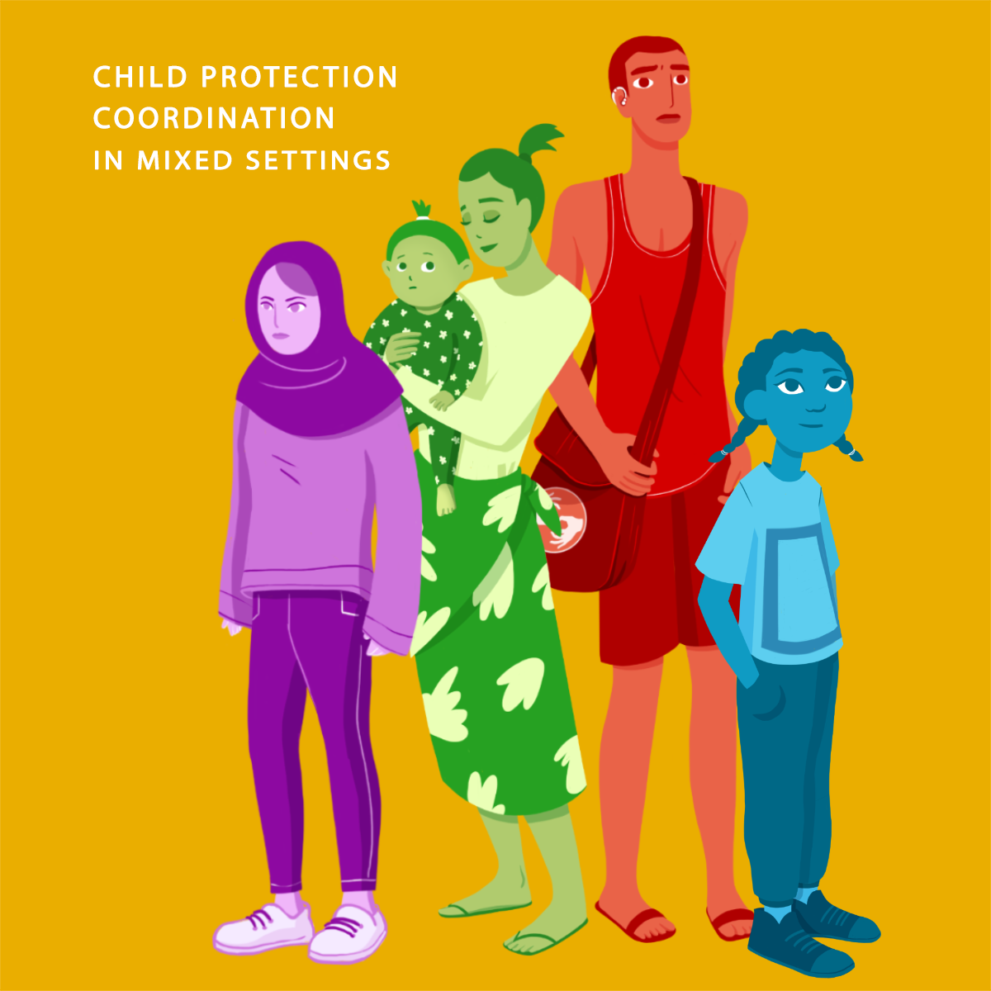

Please take 3 minutes to give us your feedback
https://forms.office.com/e/Z8BeSTMkt4
Notes:
KARIN
2 minutes
<15:59

Slide 25
Coming up next week (Week 3)?
Webinar #5:
  Information Management for Coordination on July 25th
  Get ready for next week by watching any webinars you may have missed.
  If you haven’t already done so, you should also carefully read the Joint UNHCR-OCHA Note on Mixed Situations!
Notes:
KARIN
1 minute
<16:00

